Slide 1
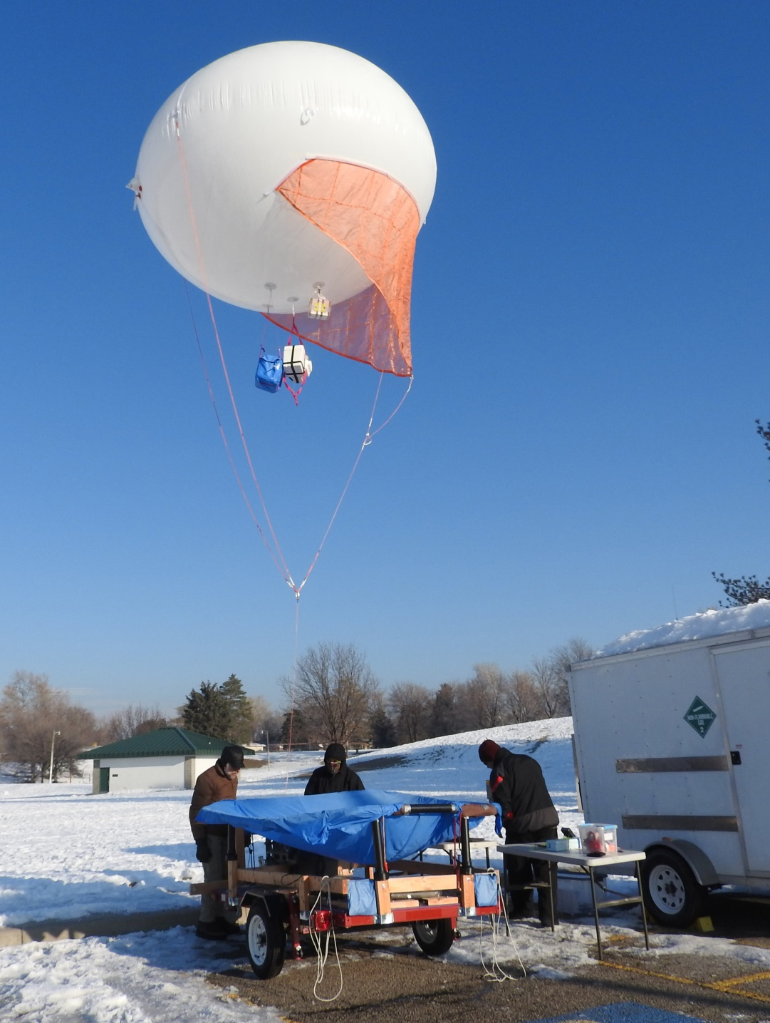
Weber State University, Physics
Aerostat operations
0 to 500 foot vertical profiles
Multiple particulate size measurements
Gas measurements:
Ozone, ammonia, CO, NO₂, and SO₂

Slide 2
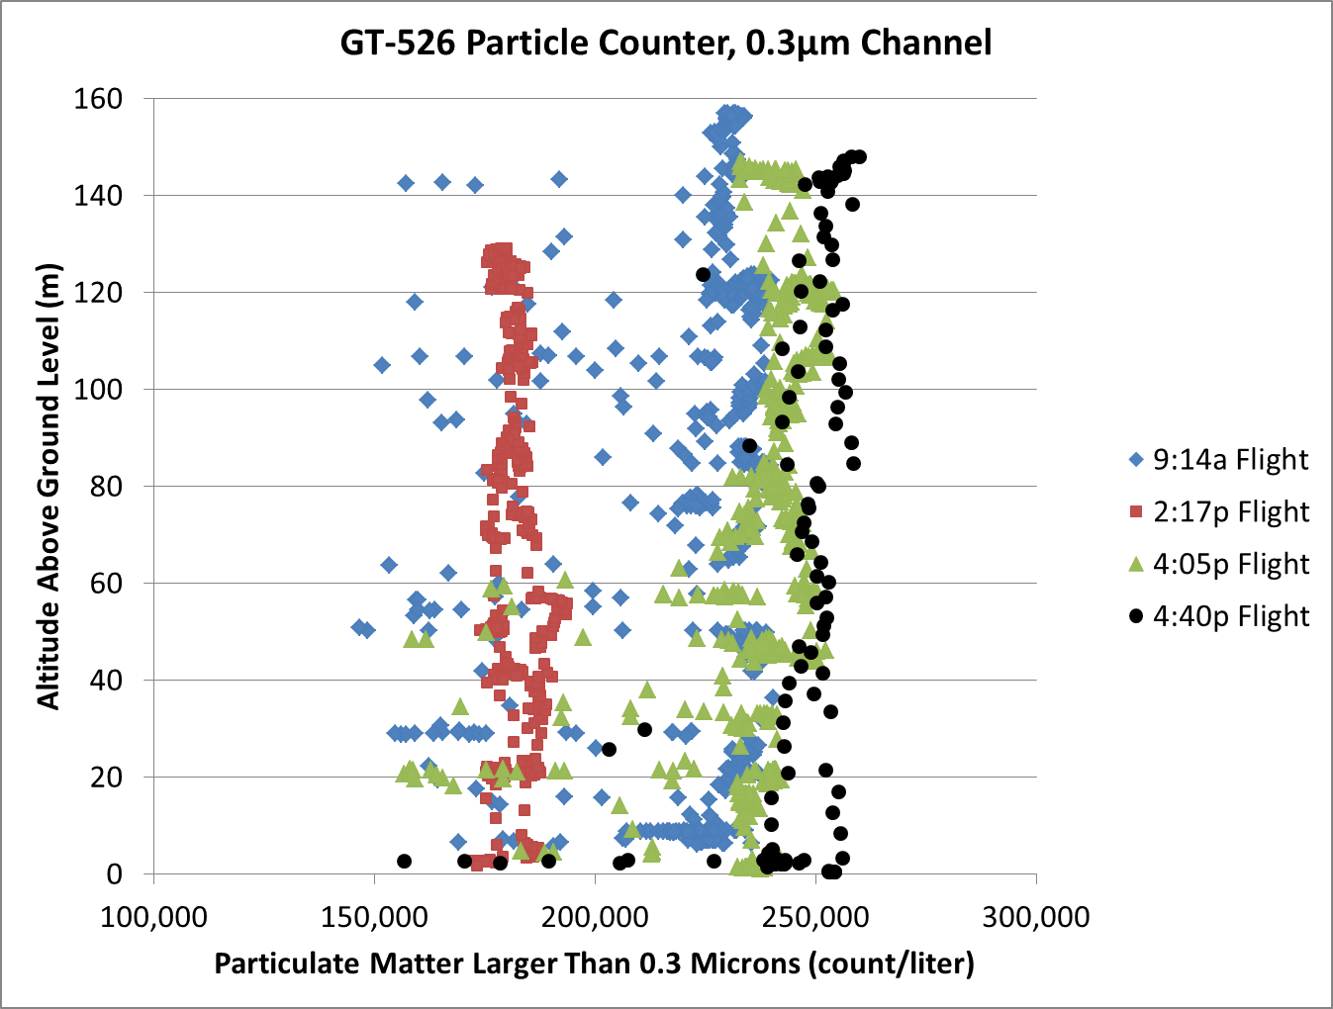
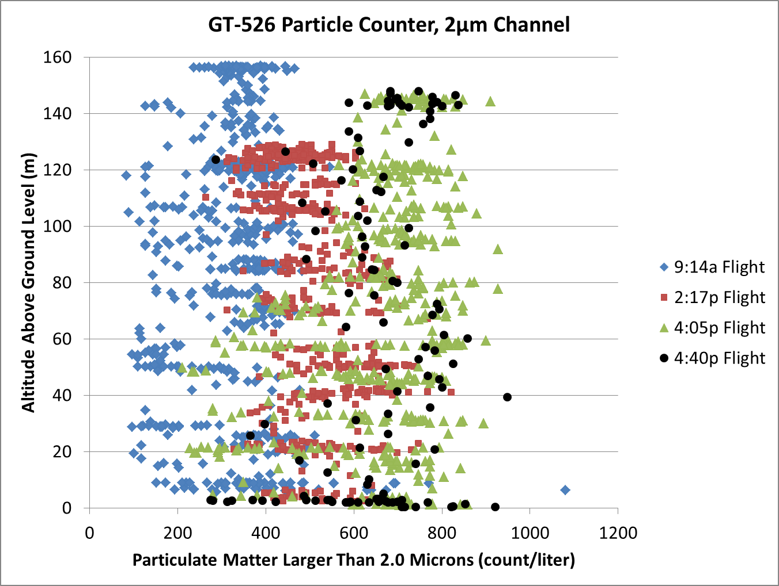
Particulates Evolve During the Day but are Reasonably Uniform in Altitude
The smallest particles are more uniform in the vertical column and become better defined over the day. The larger particles are more random in quantity at any altitude, but show a similar time evolution as the smallest particles. The progression in behavior from the smallest particles to the largest is smooth with no evidence of any jumps.

Slide 3
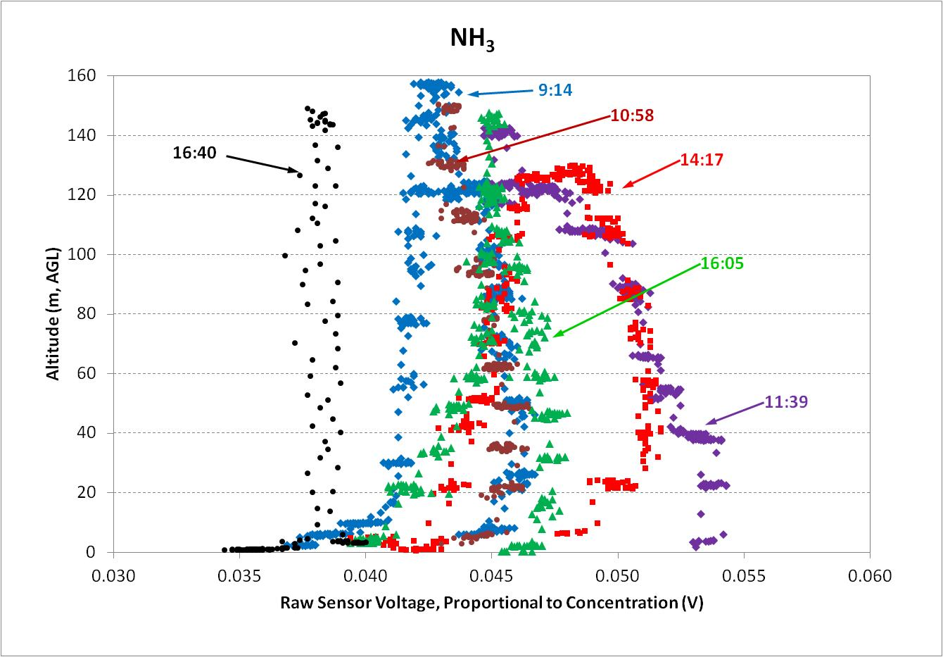
Gas Analysis is Still in Progress Ammonia seems to be the most interesting.
Ammonia starts out reasonably uniform in the vertical column. In the middle of the day the levels change quite a bit with altitude and evolve in time. By late afternoon the ammonia levels become uniform again in the vertical profile.

