Slide 1
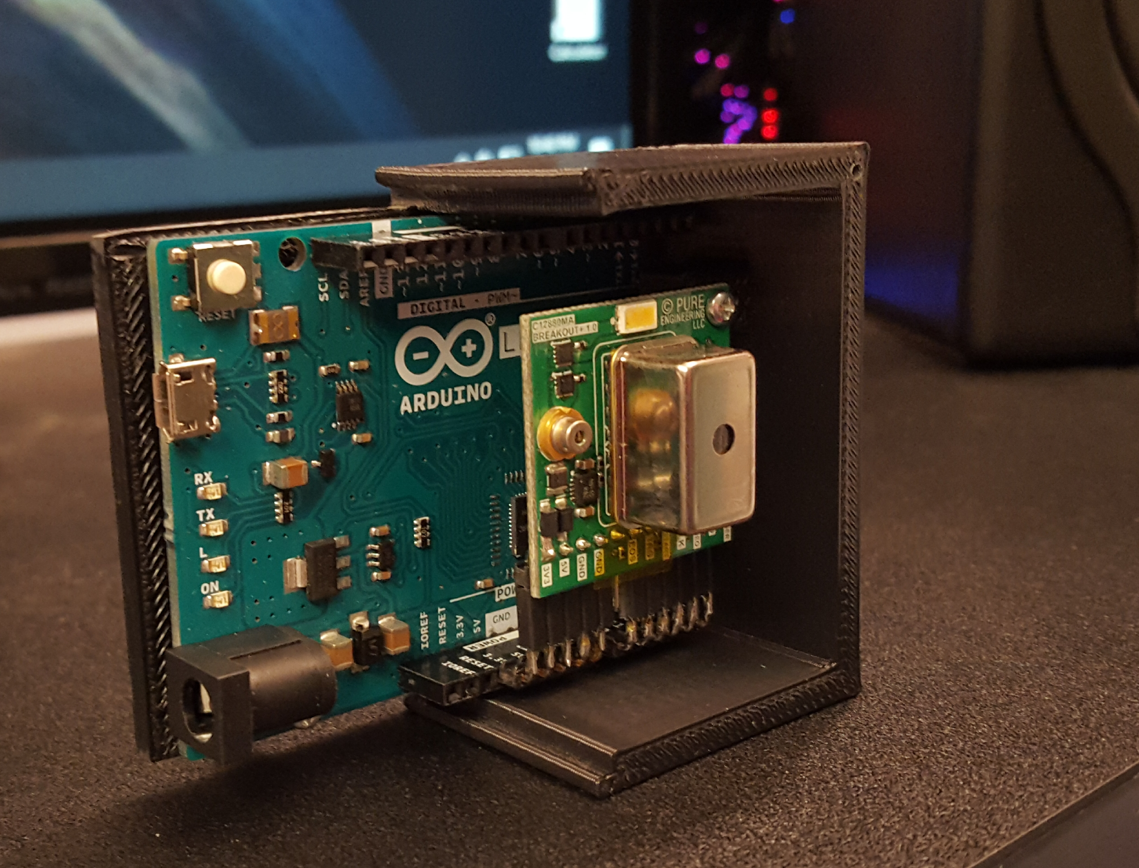
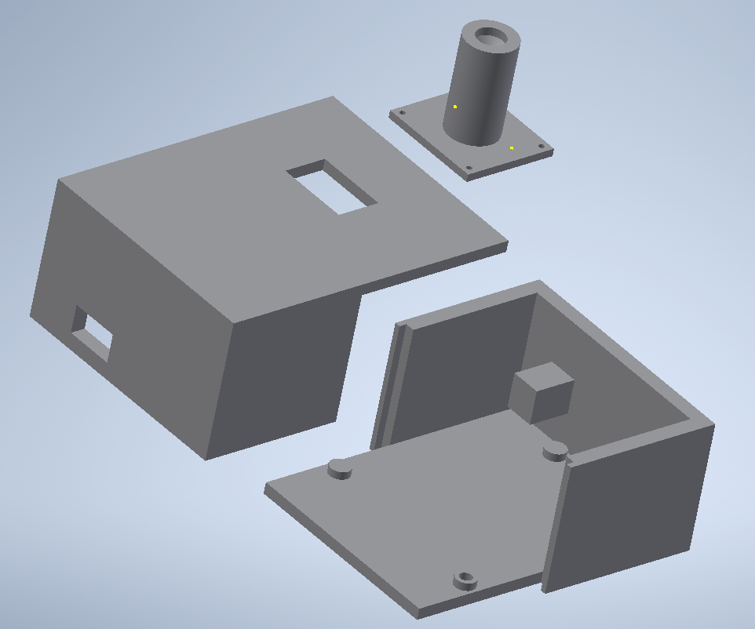
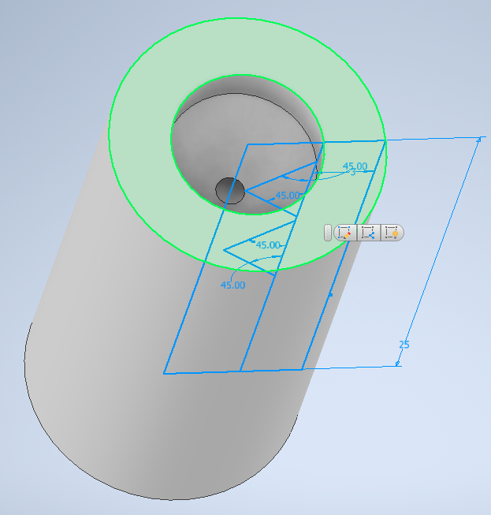
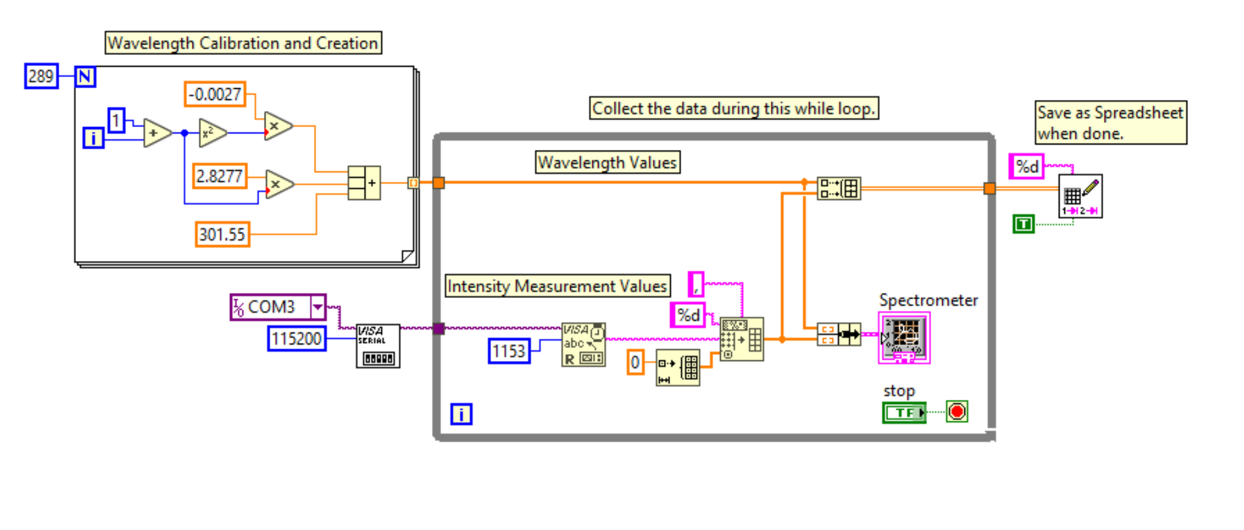
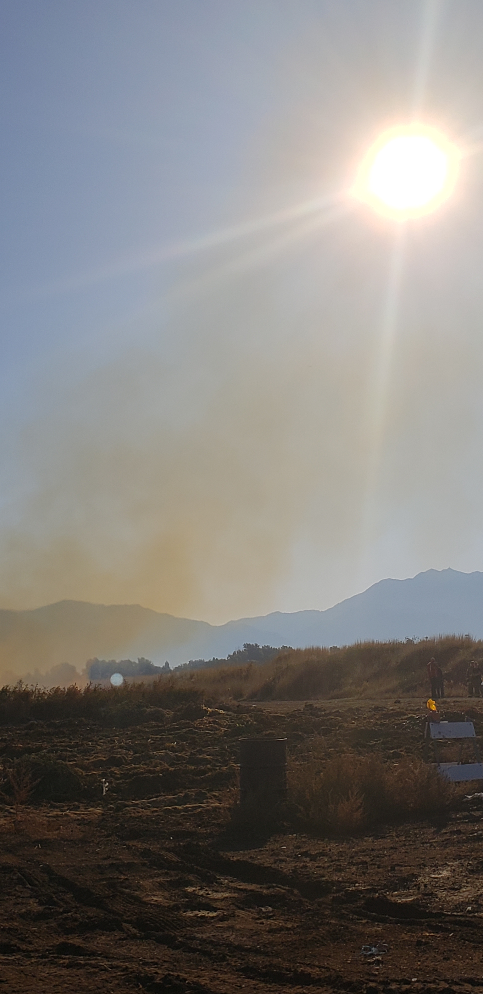
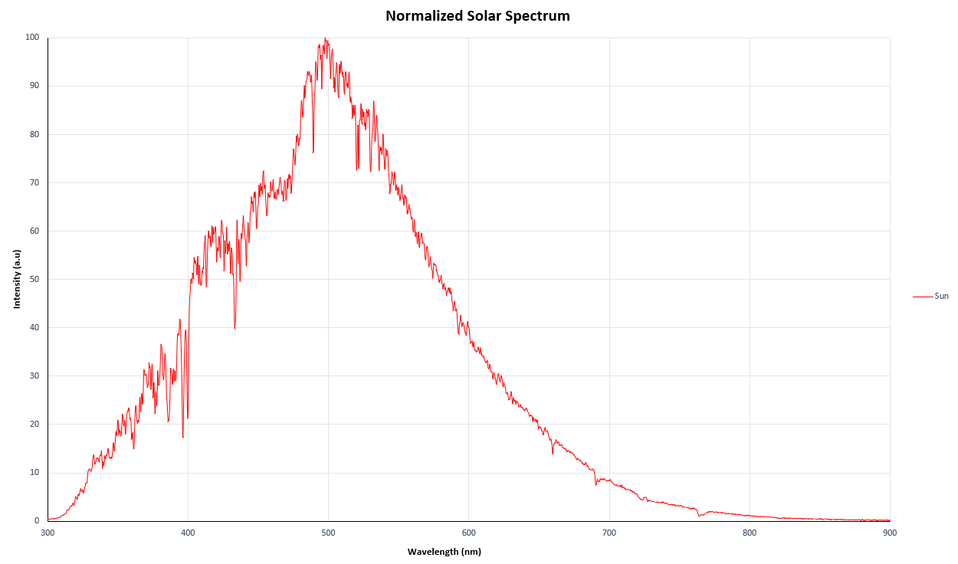
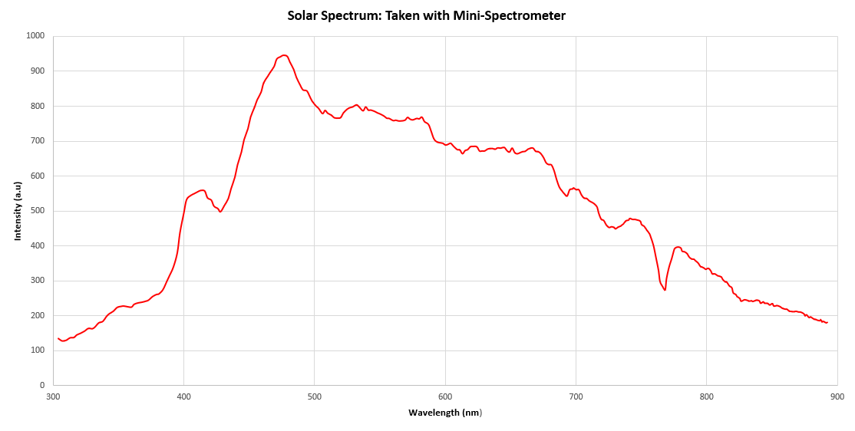
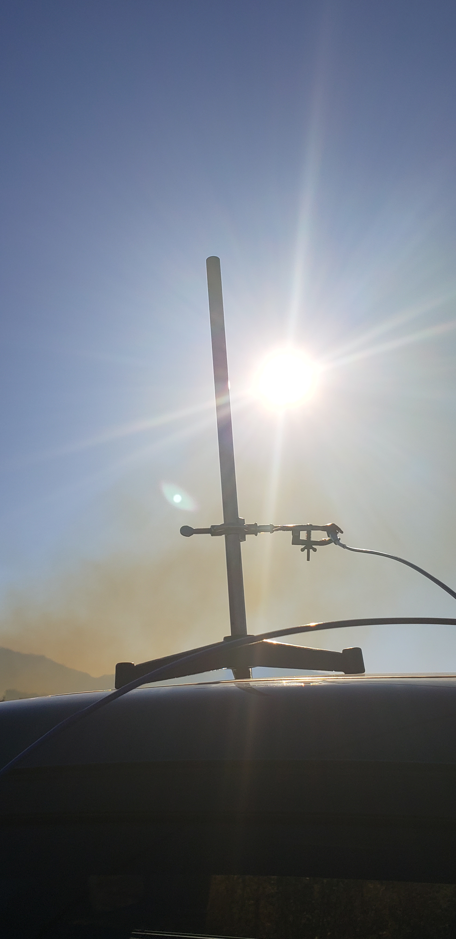
Measuring Wildfire Smoke with a Miniature Spectrometer
Jeff Kindall, John Sohl, Dept. of Physics, Weber State University
Background
Device
A major component missing from most small atmospheric research teams is the utilization of spectroscopy for atmospheric measurement. This is primarily due to the cost, size, and durability of most spectrometer systems. However, spectrometer technology is becoming more affordable and compact, opening the possibility of field use for small research teams. Our group, HARBOR, takes ground/air-based atmospheric measurements. The purpose of this project was to take measurements of the solar spectrum under clear conditions and pollution conditions. Comparison of the spectra could possibly be used for determinations about atmospheric pollution. Simultaneously, develop a miniature spectrometer system that would be ideal for field use. Lastly, compare the spectra between both devices
Housing Design
Problem
Figure 1. Finished spectrometer system. The spectrometer is a Hamamatsu C12880MA breakout board attached to an Arduino Leonardo PCB board. Spectral response: 340nm – 850 nm, spectral resolution: 15 nm, number of pixels: 288, weight: 5 g.
The problem was to use a high-resolution optical band spectrometer to take solar spectra in close proximity to a controlled brush burn, simulating pollution conditions. To program, design, and implement a miniature spectrometer system that demonstrated reliability and portability.
Figure 2. Entire spectrometer housing (Left). Designed in Autodesk inventor. Multiple component designed for adaptable use in field and laboratory settings.
Data
Method
Using a high-resolution Ocean Optics HR4000CG-UV-NIR spectrometer, the fiber optic end of the spectrometer was pointed directly at the Sun to obtain a solar spectrum. The device was then shifted a few degrees off angle to gather a comparison spectrum. The two spectrums were then normalized to look for wavelength discrepancies. Many spectra were taken over the duration of the burn.
Discussion
Upon initially testing four different pumps at various power outputs, the Furgut DC06/21FK was seen to have the most flow output and the Ozonesonde pump had no observable flow output. For this reason, the Ozonesonde pump was taken out of the following tests.
After comparing flow output values compared to power draw from the pump, it can be seen that the Furgut DC06/21FK is by far the most efficient pump by using less than 0.5W while outputting up to over 3.5 liters/ minute. The Furgut DC608 uses the most amount of power on average and outputs a maximum of 1.7 liters/minute. The Furgut 8891 at it’s highest speed outputs no more than 0.7 liters/minute.
Set Up
Conclusions
The controlled burn was located in Plain City, Utah. The spectrometer system was mounted atop my vehicle with
The results showed a very distince spectral extinction signature Our results showed us that the Furgut DC06/21FK pump produced the most amount of flow with the least amount of power draw at atmospheric pressure. The Furgut8891 showed the greatest response to varying pump speed but overall showed least amount of flow to power efficiency.
Next Steps
We would like to continue testing in order to produce more detailed graphs with more data points. This data will then be available for outside use for others conducting similar research.
Figure 3. Comparison spectra of the controlled burn between the high-resolution spectrometer and the miniature spectrometer. Differences in spectra primary in the near infrared region can be explained by the responsivity curves for the individual instruments.

