Slide 1
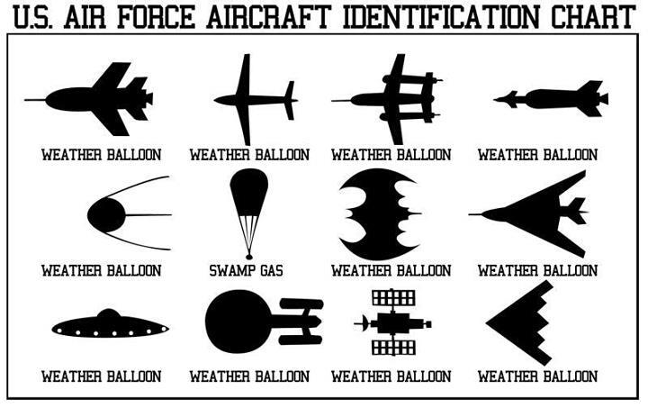

Slide 2
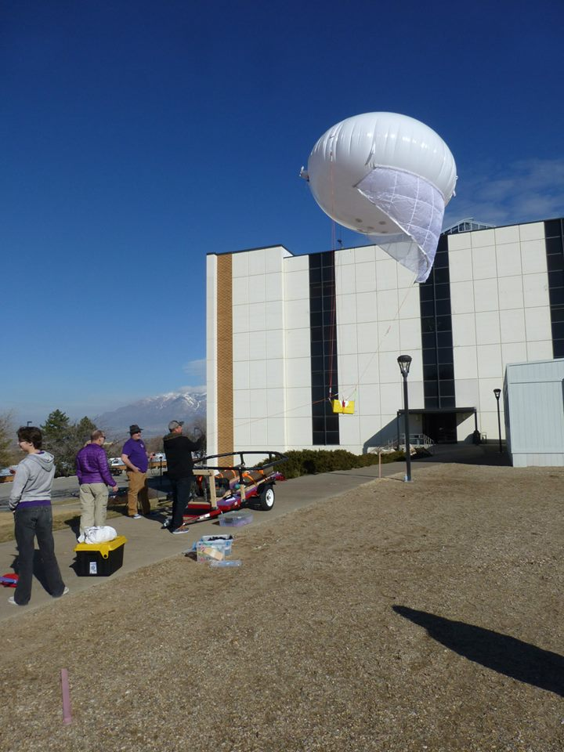
High Altitude NASA-Styled Research by Undergraduates
John Sohl
Weber State University
HARBOR Team
for
Utah State University

Slide 3
Overview
What is HARBOR?
High Altitude Flight Platform
Low Altitude Flight Platform
Typical Mission
Fun with the BBC

Slide 4
What is HARBOR?
High Altitude Reconnaissance Balloon for Outreach and Research
A mission oriented team project for the exploration of Earth’s atmosphere.
Multidisciplinary educational platform
Employment training!

Slide 5
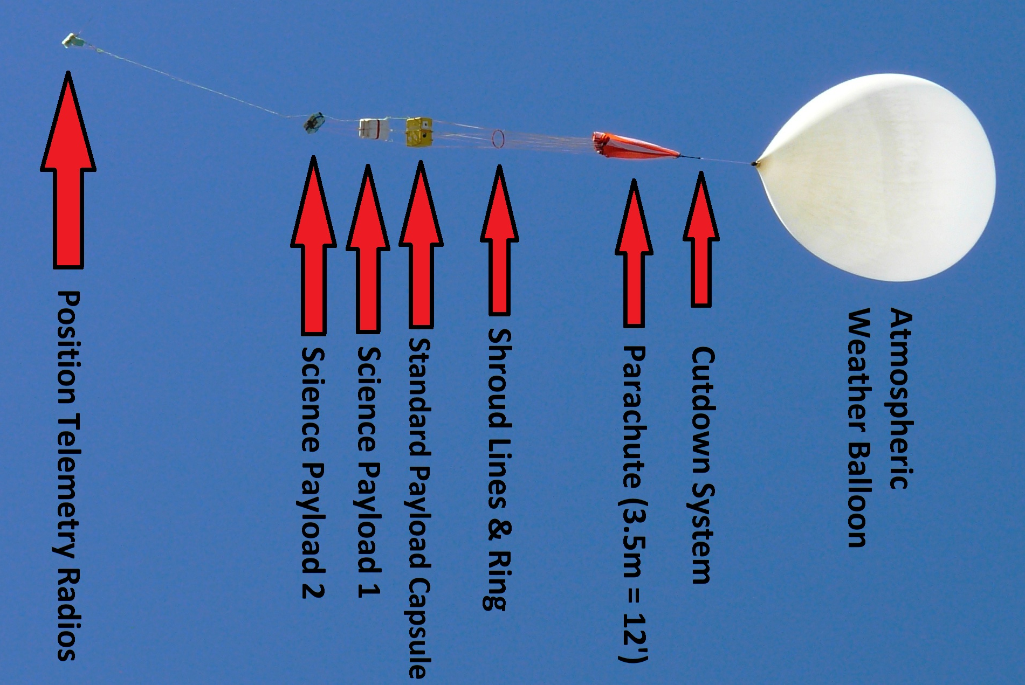
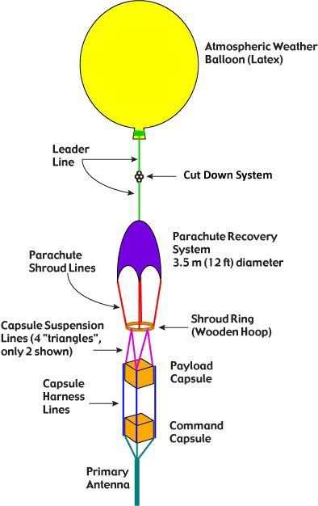

Slide 6
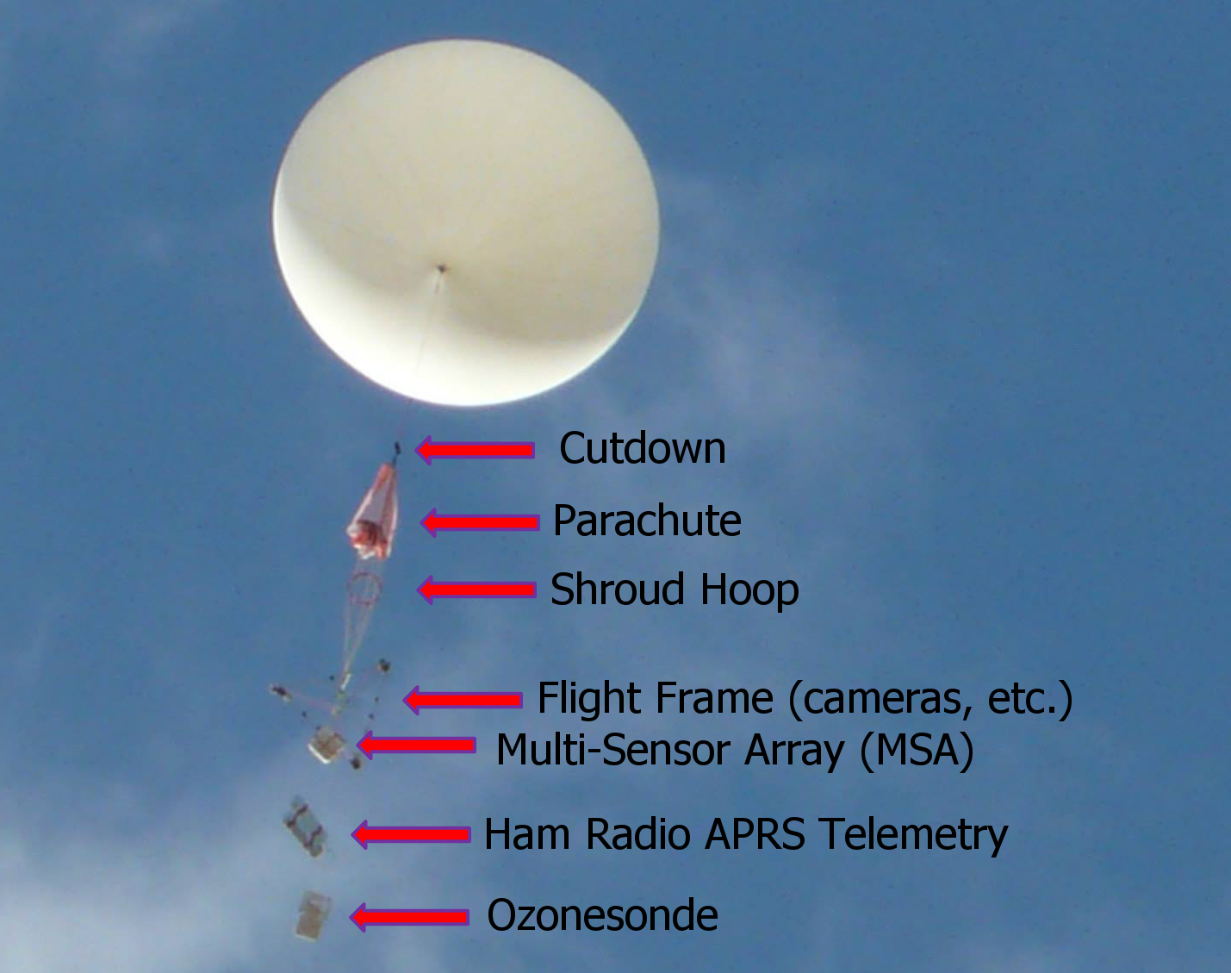

Slide 7
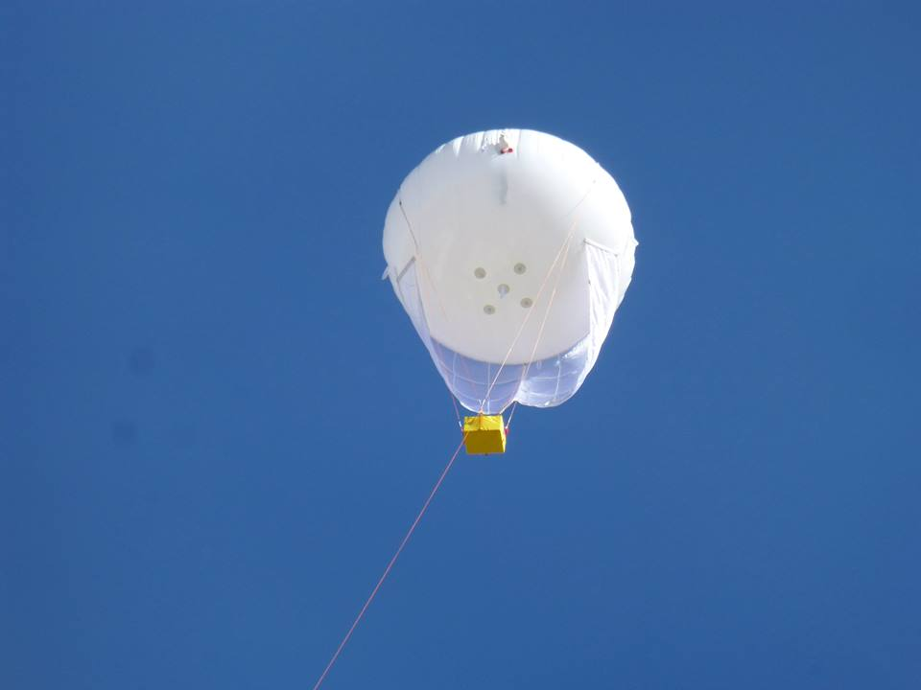
Aerostat
Wing
Payload
(2kg, max)
Helium
Winch

Slide 8
Lift
Drag
Pressure

Slide 9
Aerostat
Blimp
50+ MPH
Wind stable
Balloon

Slide 10
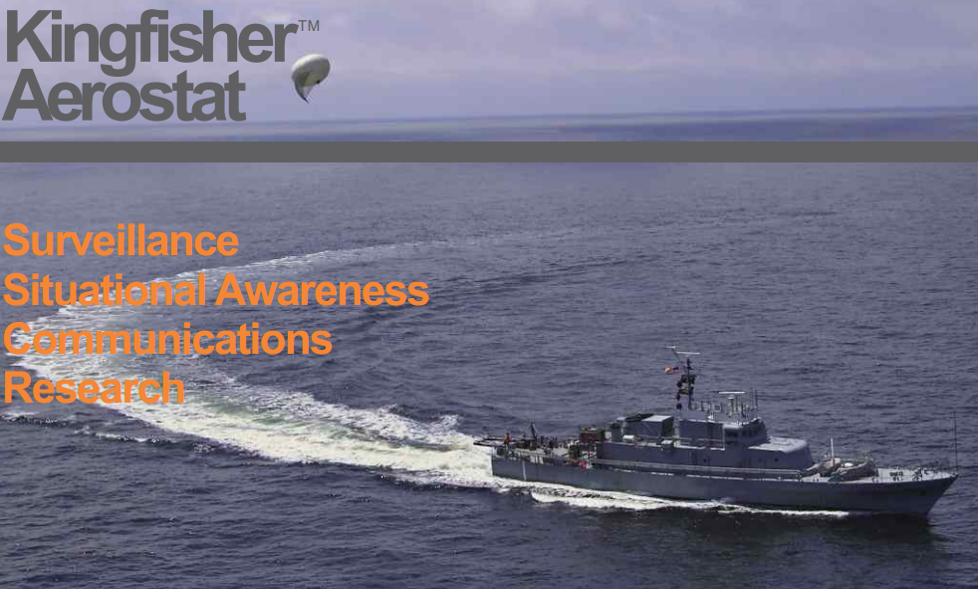
We Don’t Need a Bigger Boat

Slide 11
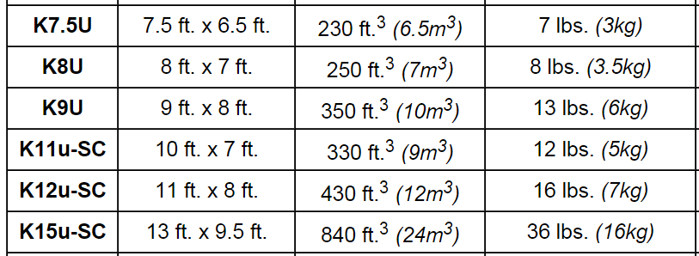
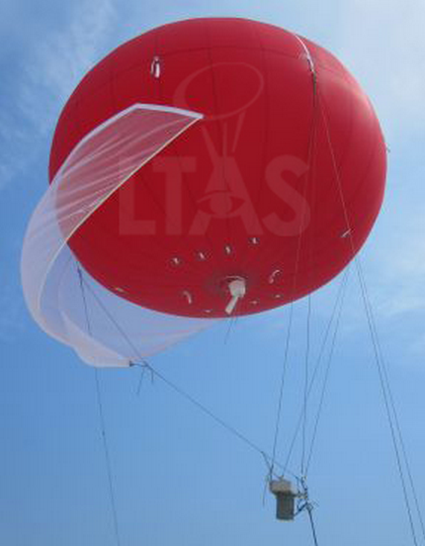
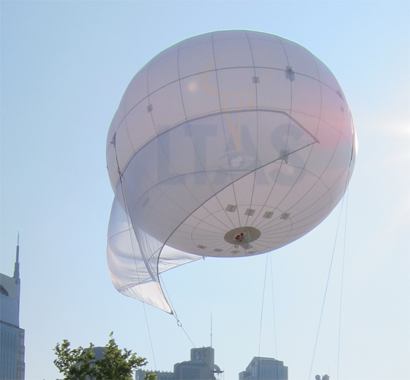
Our Aerostat

Slide 12
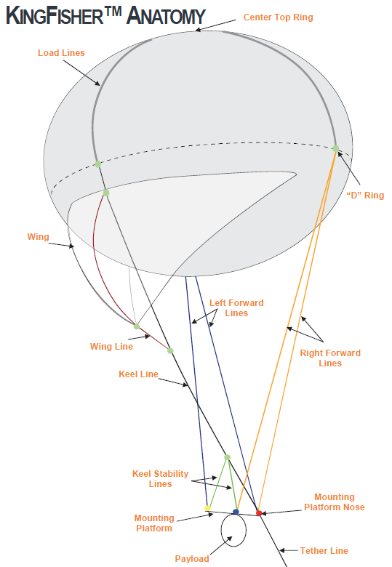

Slide 13
Aerostat Goals
Two “campaigns”
Winter inversions
Summer ozone
Initial heights 500’ or 1000’, future: 1km (3,300’)
Winter Air Measurements (Bold= sensors are ready.)

Slide 14
Sensor Suite
Sensor | Operational | Calibration
PM2.5 | ü 0.6% rms FS error | Secondary
NO₂ | ü 4% rms FS error | UDAQ
O₃, Solid State | ü 3% rms FS error | UDAQ
O₃, Ozonesonde | ü | NOAA
SO₂ | ü | Pending
CO | ü 0.2% rms FS error | UDAQ
CO₂ | Prototype | Pending
VOC | Prototype | Pending
NH₃ | ü | None yet
%RH (in/out) | ü | Secondary
Temperature (in/out) | ü | Secondary
Pressure | ü | Secondary
Air Flow | ü | Factory
GPS | ü | Secondary

Slide 15
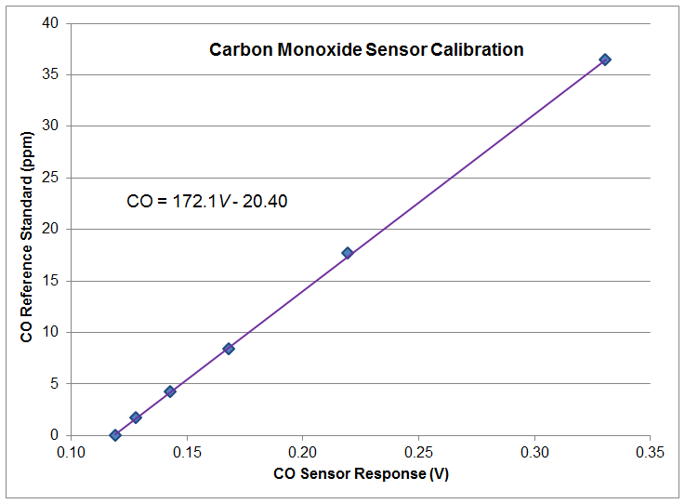
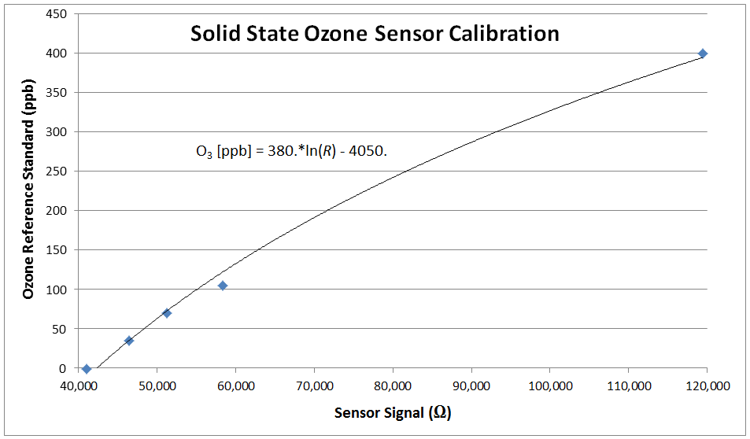

Slide 16
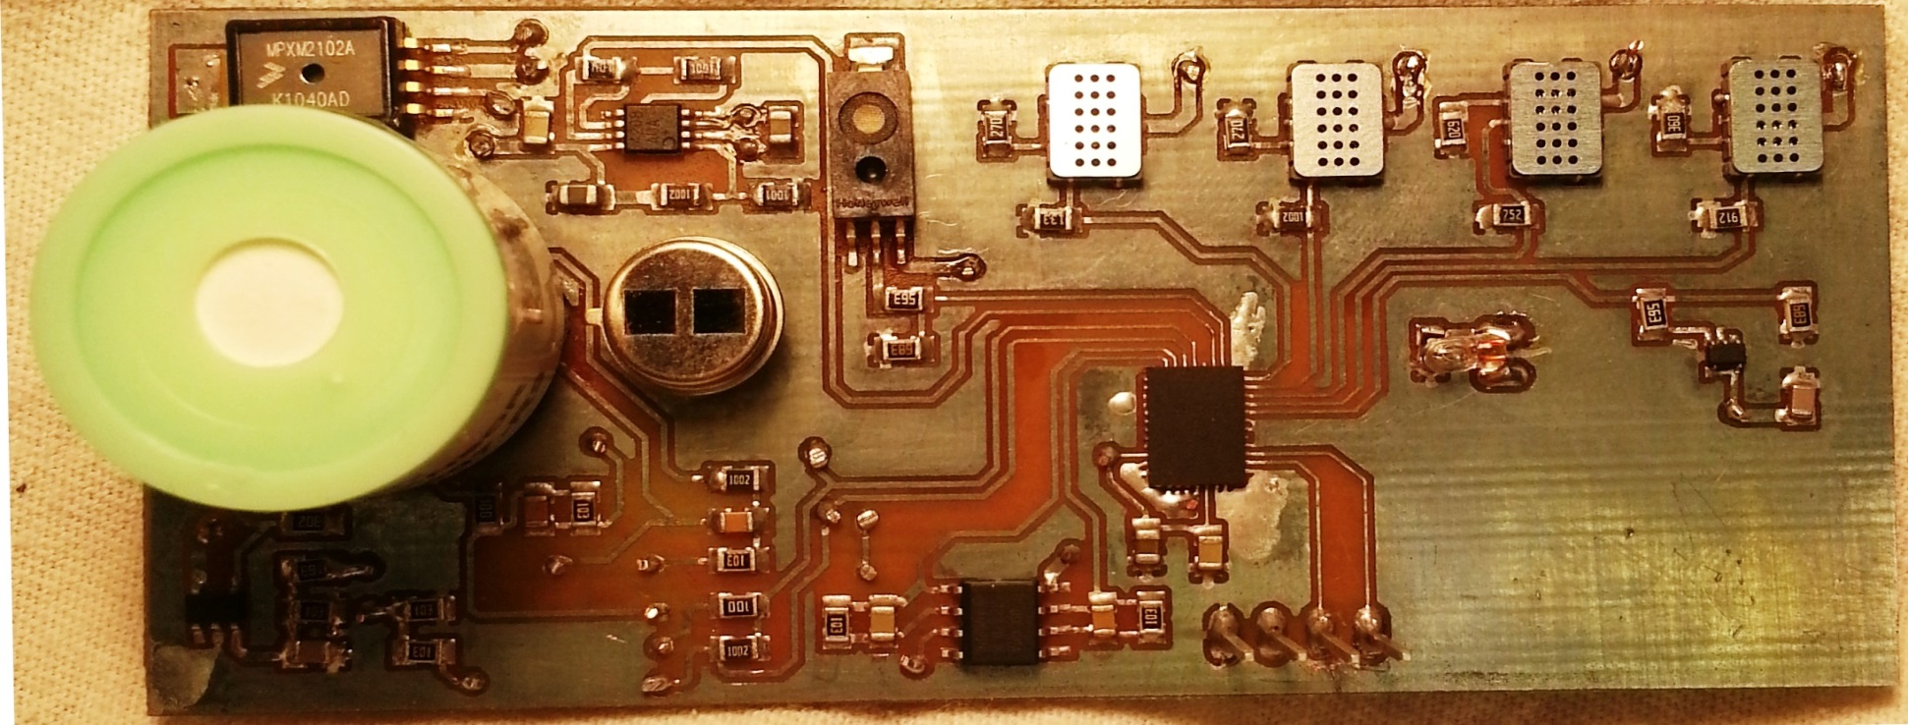
The Main Sensor Array
Pressure
CO₂
%RH
CO
O₃
NO₂
NH₃
SO₂
Multichannel
16-bit ADC
Temperature

Slide 17
Gas Prep & PM_{2.5}
Heater
Particle Separator
Particle Counter

Slide 18
The Atmosniffer
Inlet from Outside
Heater
PM_{2.5} Impactor
PM_{2.5} Optical Sensor
Temp./Humid. Sensors
NO₂ Sensor
O₃ Sensor
NH₃ Sensor
CO Sensor
%RH, Temp. Sensor
SO₂ Sensor
CO₂ Sensor
Pressure
Mass Air Flow Sensor
Vacuum Pump
Exhaust to Outside
Direction of Air Flow

Slide 19
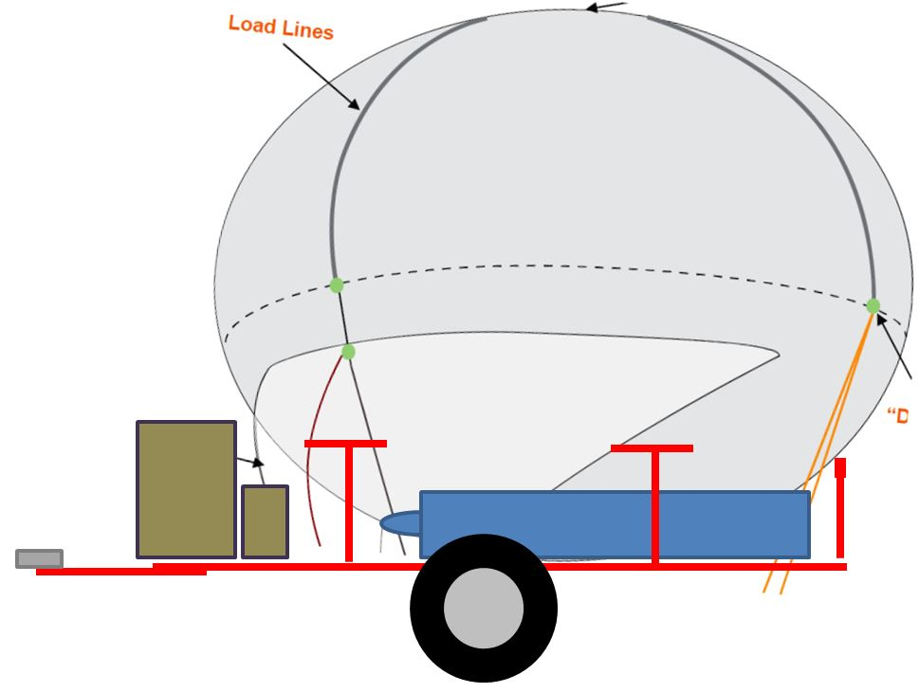
Gotta Get It There

Slide 20
Storage for Deployment

Slide 21
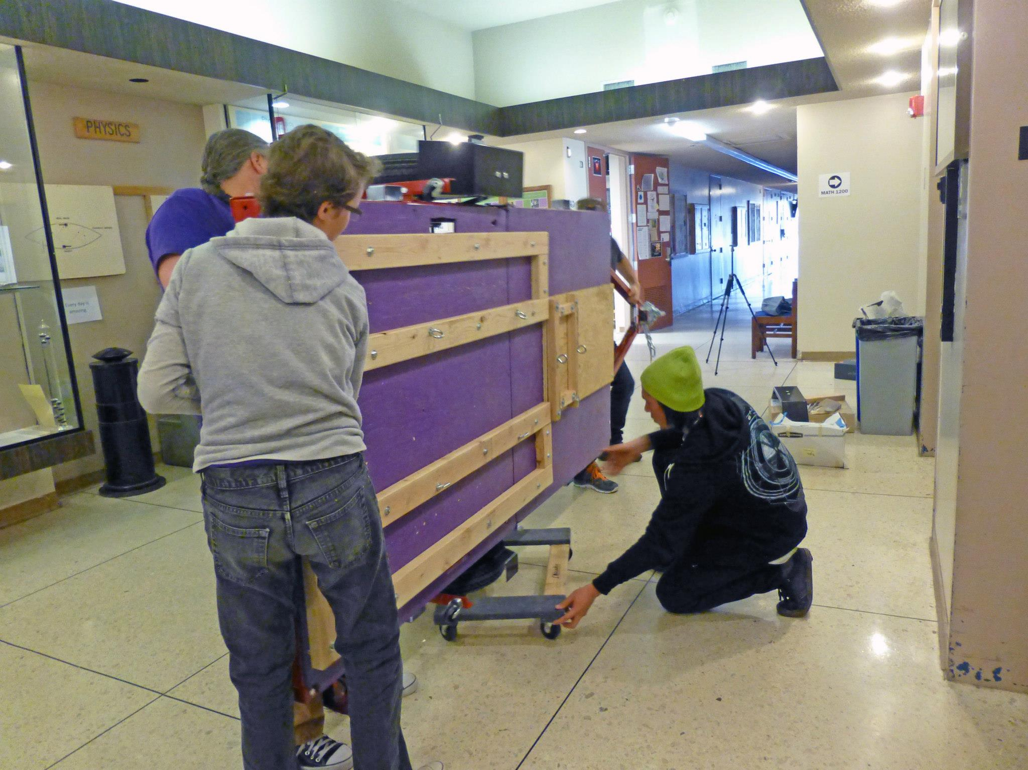
First Flight

Slide 22
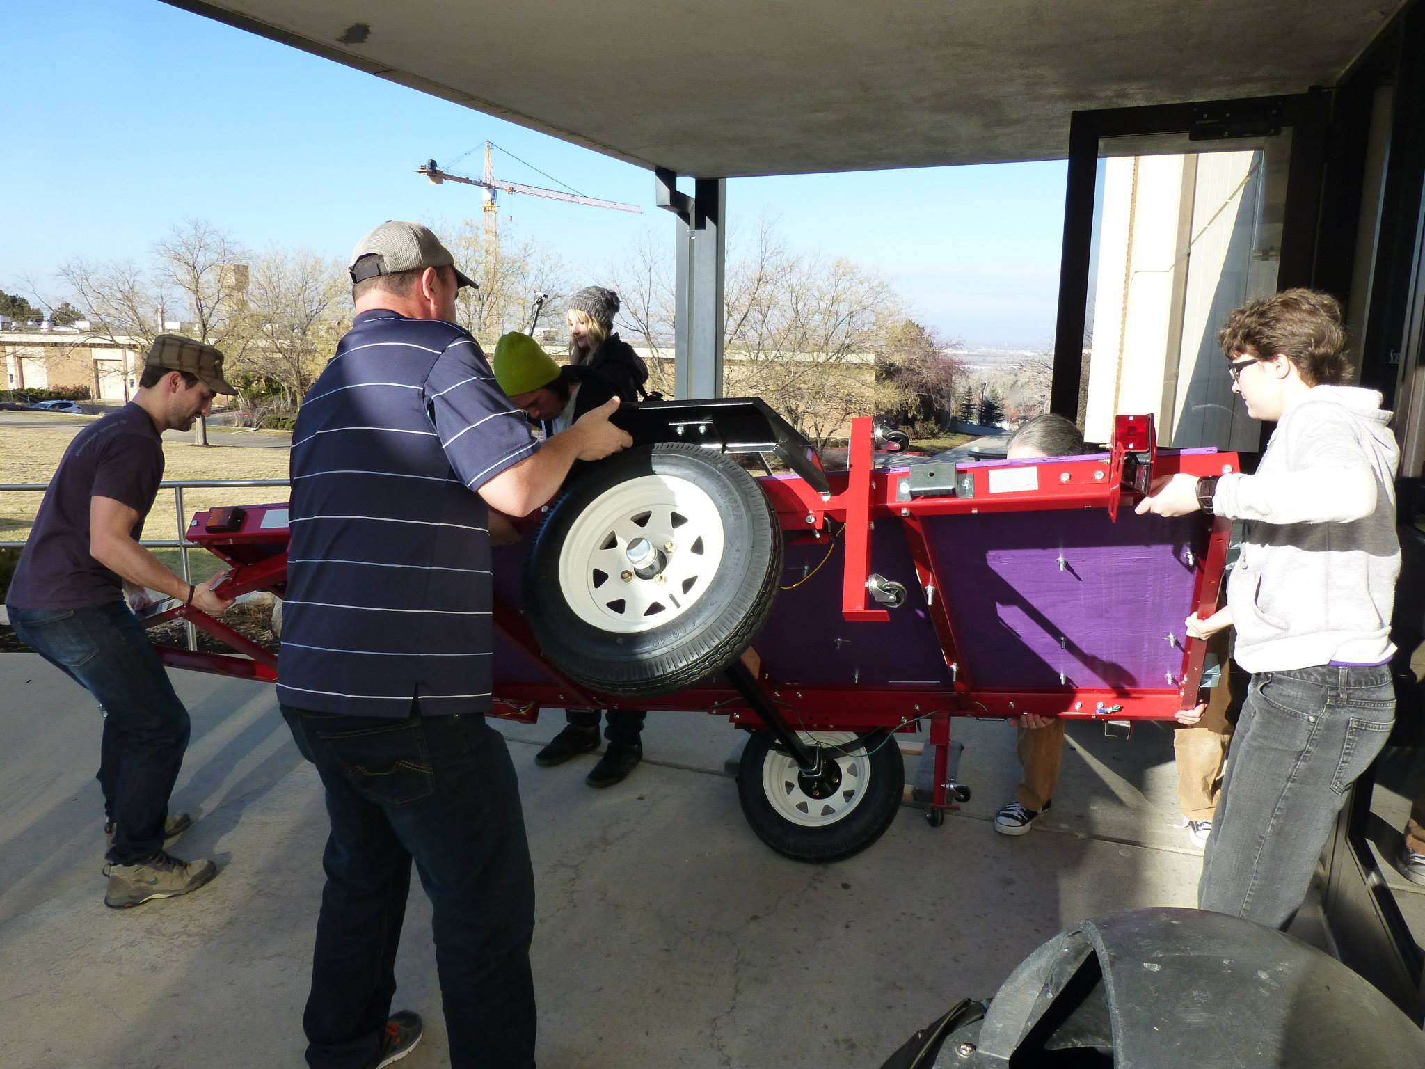

Slide 23
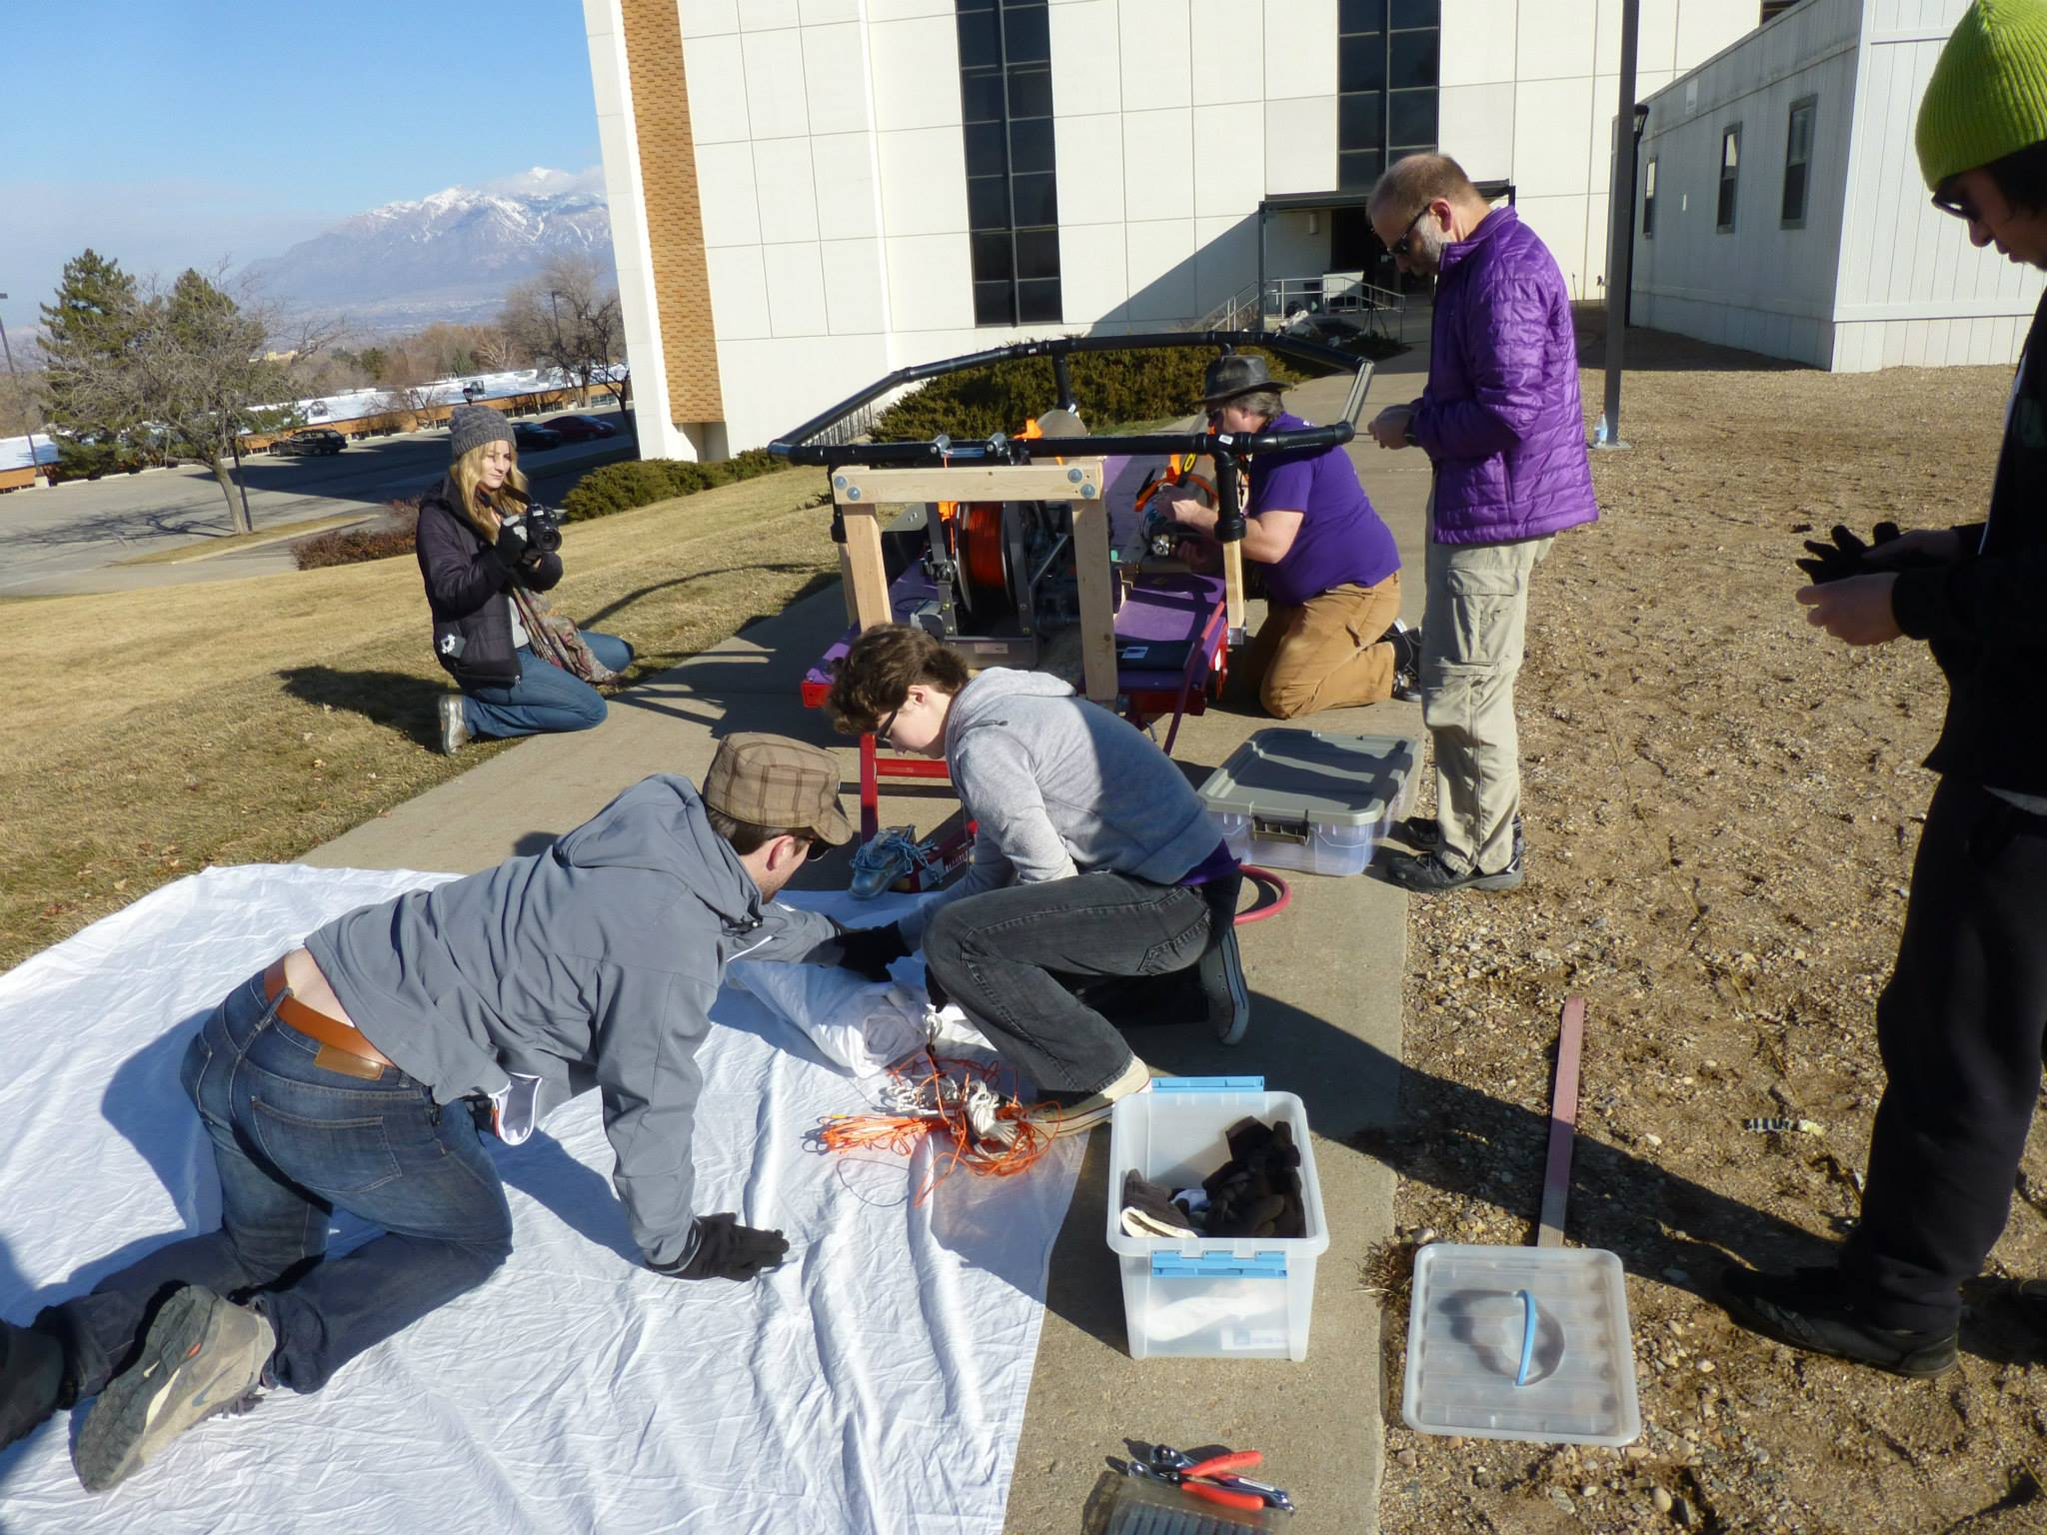

Slide 24
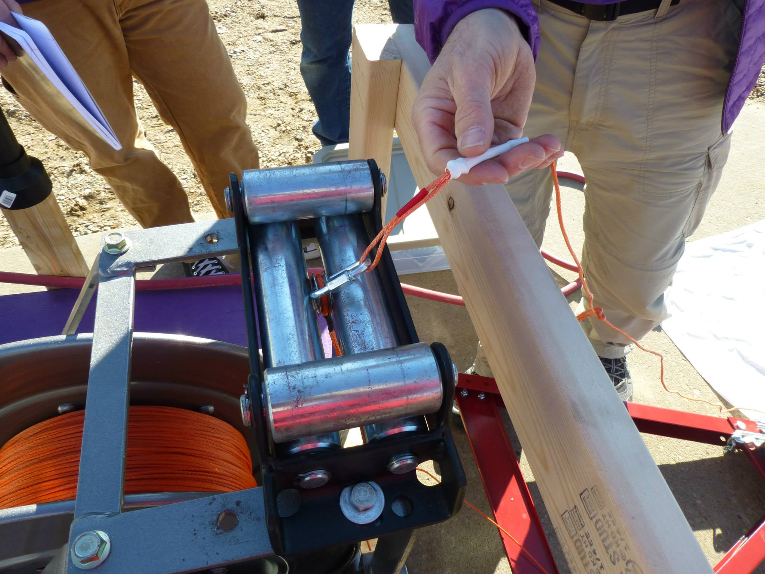

Slide 25
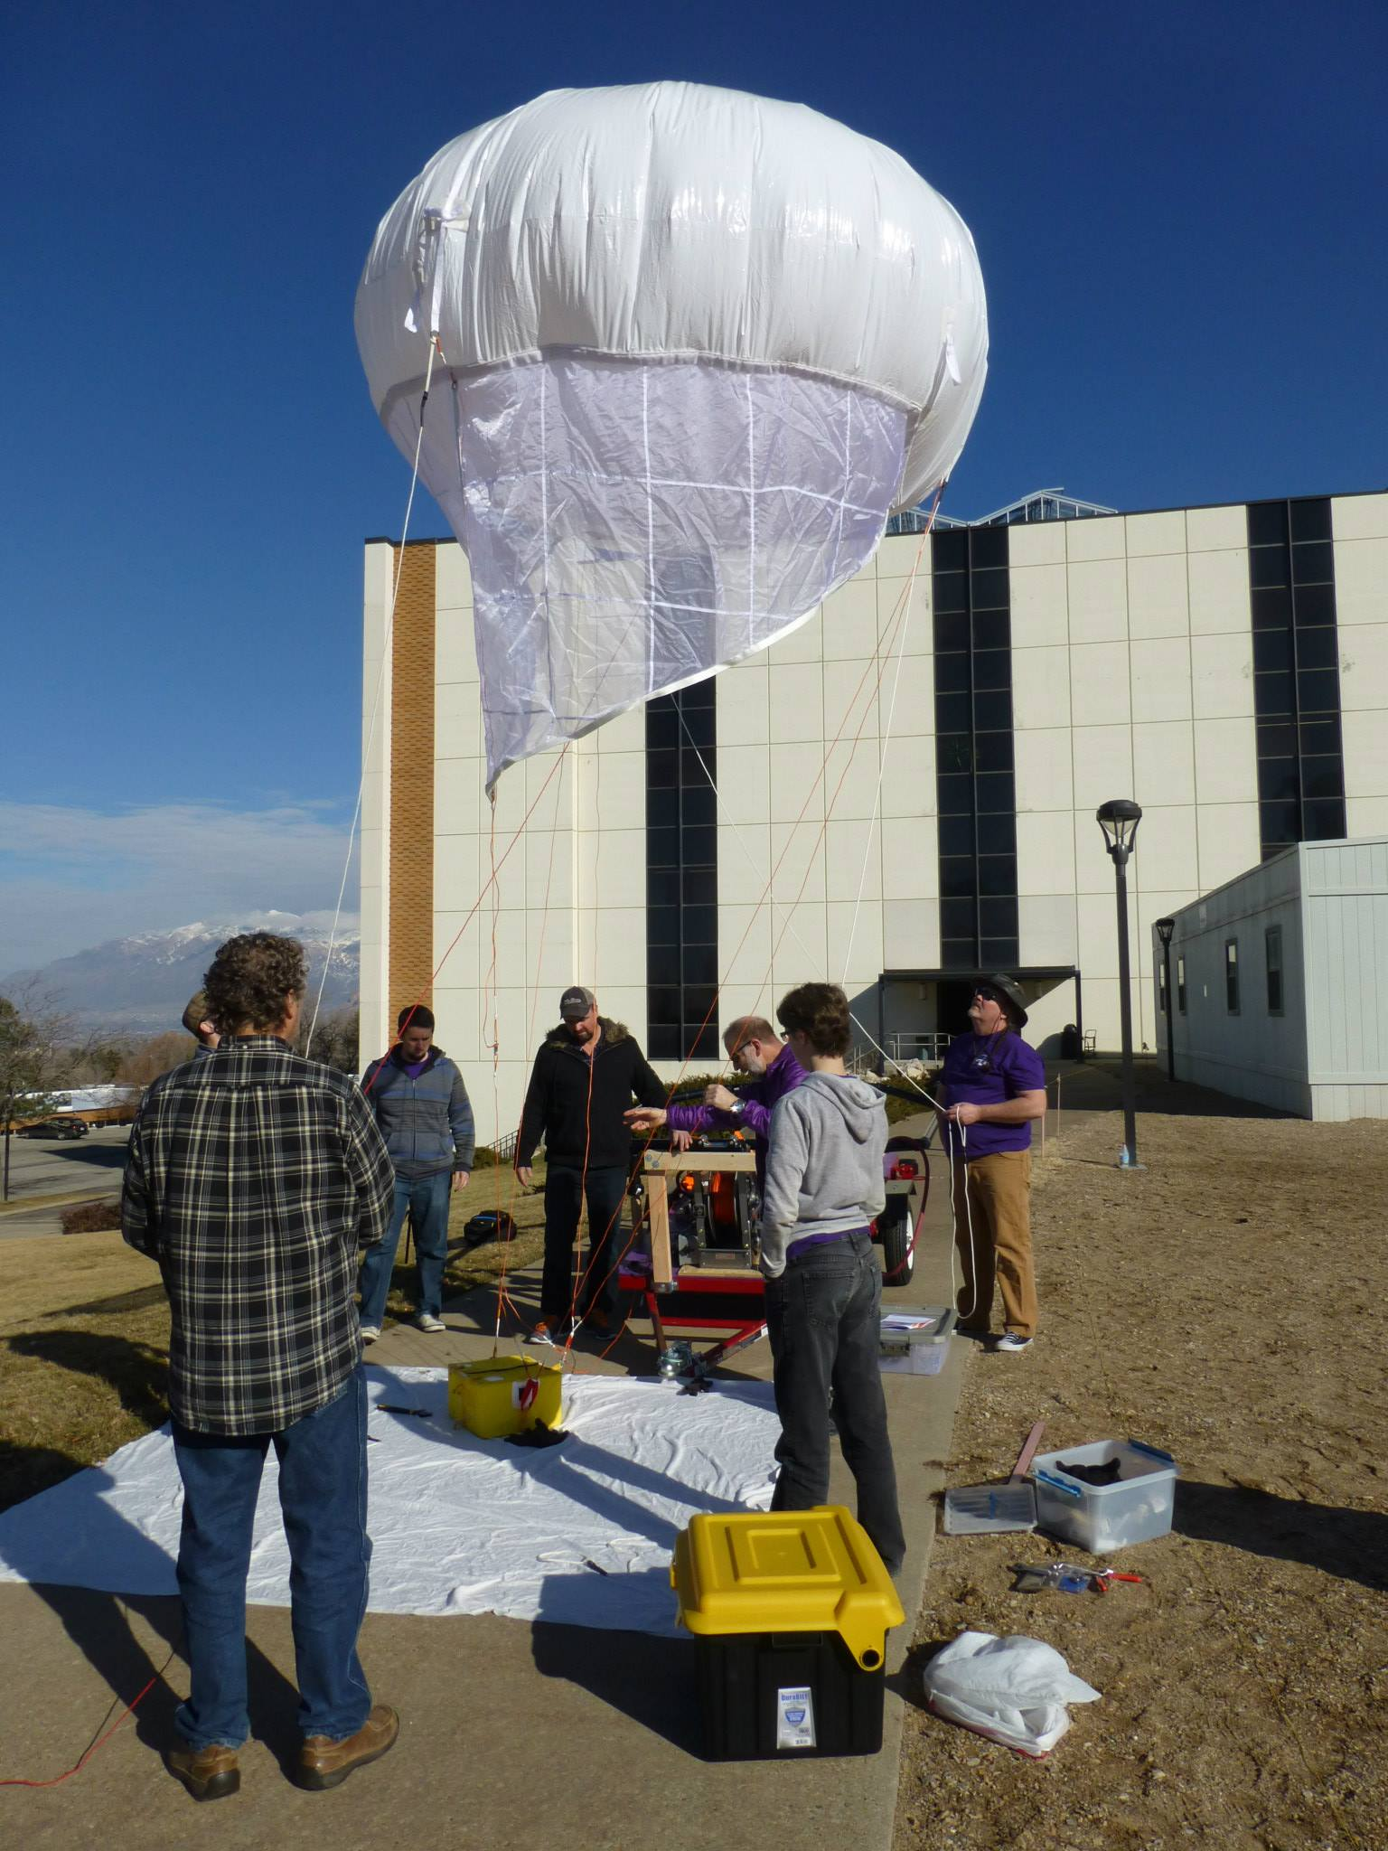

Slide 26
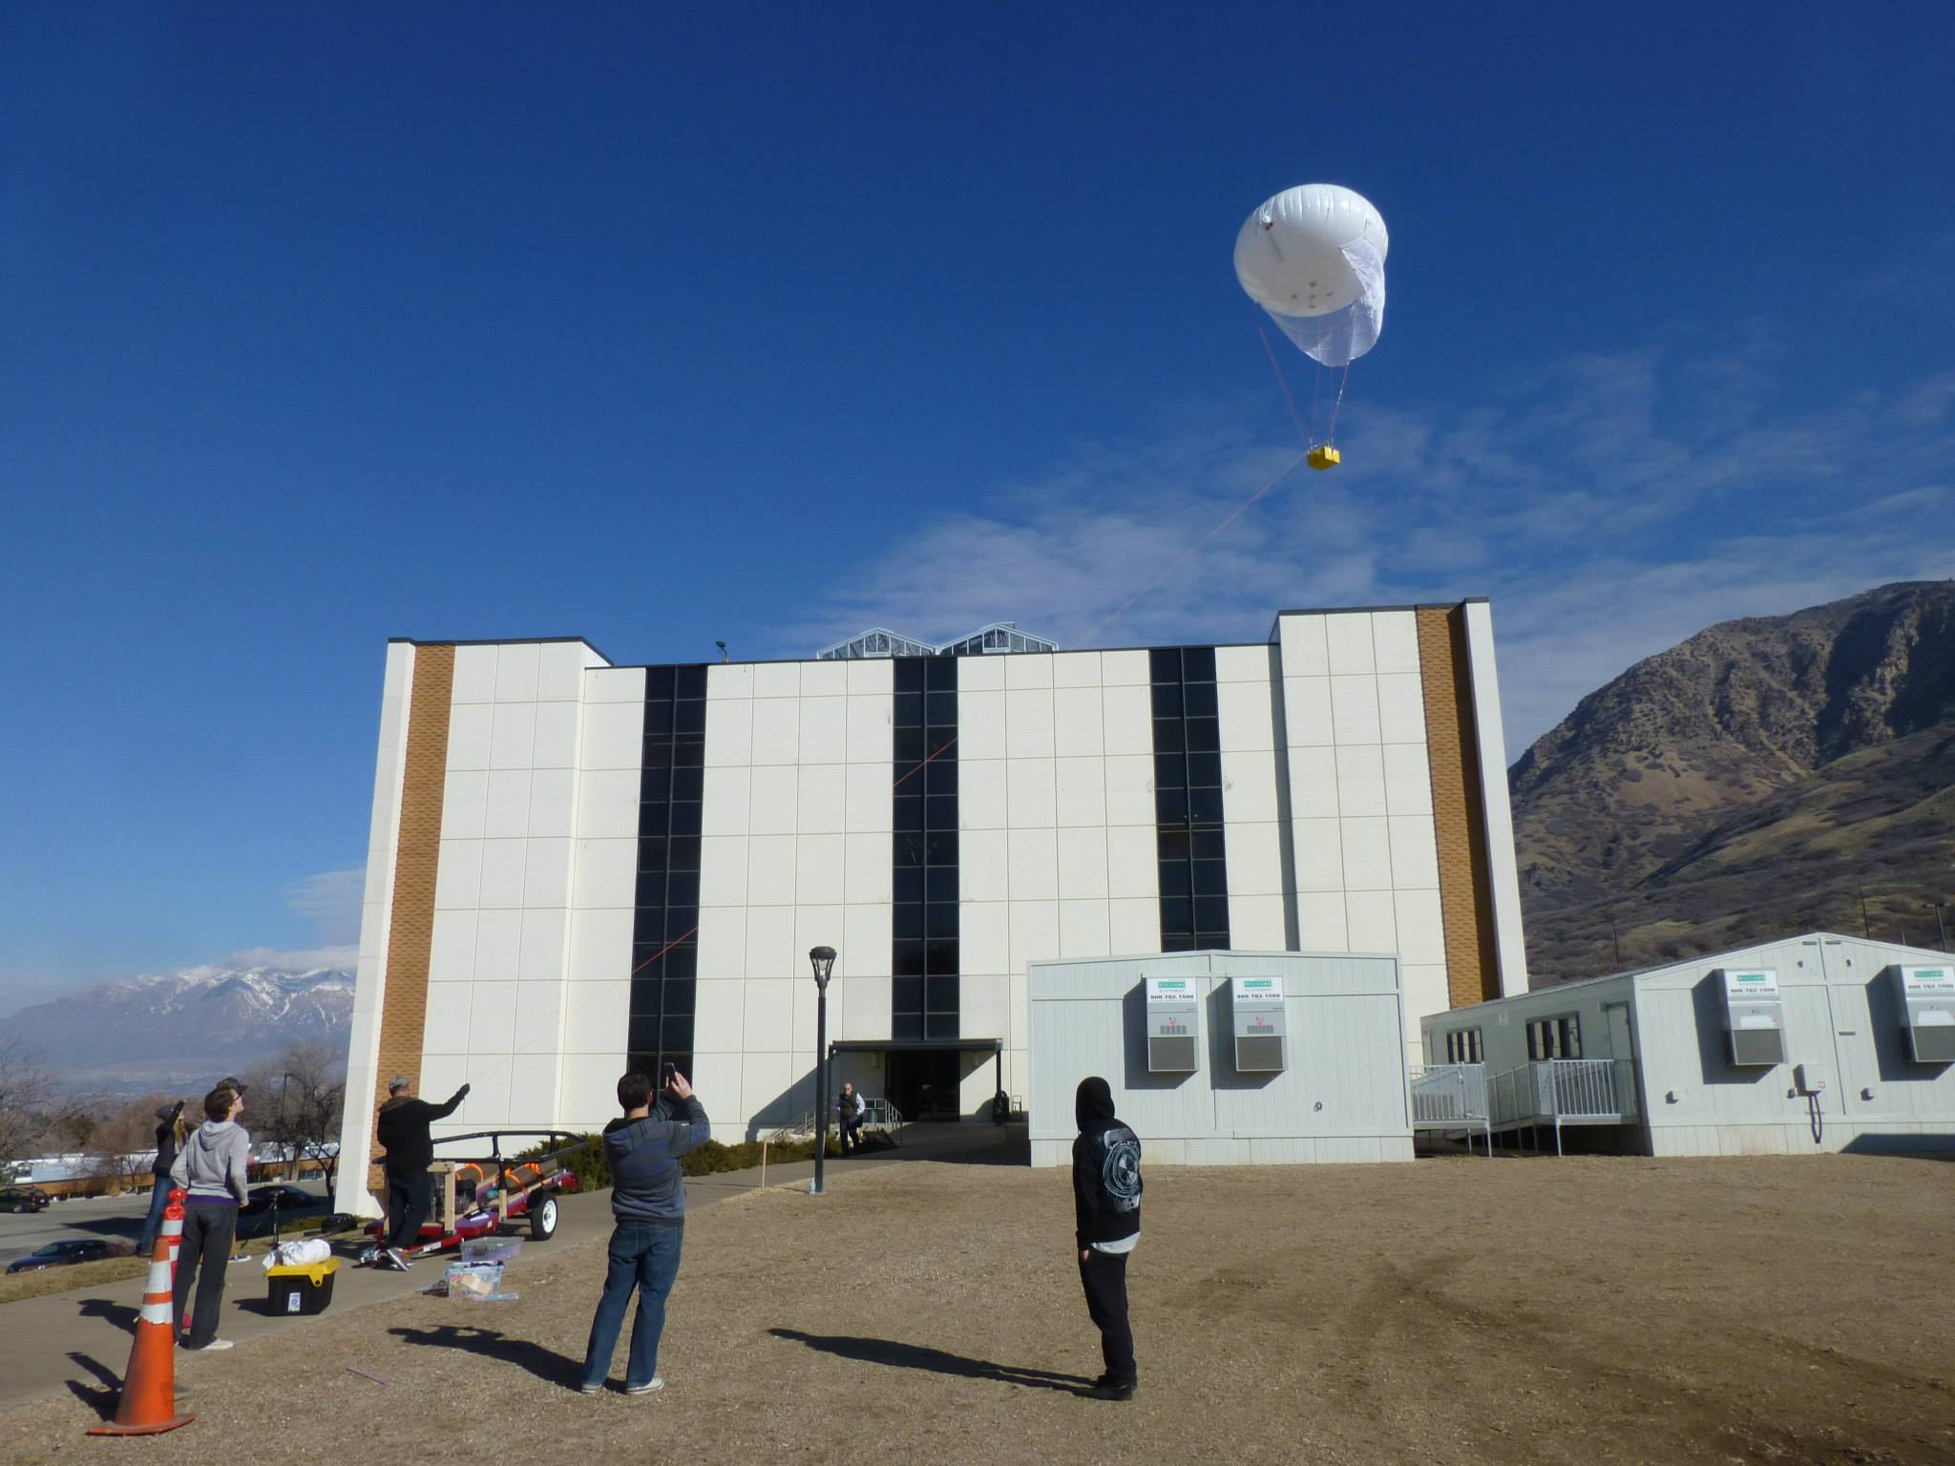

Slide 27
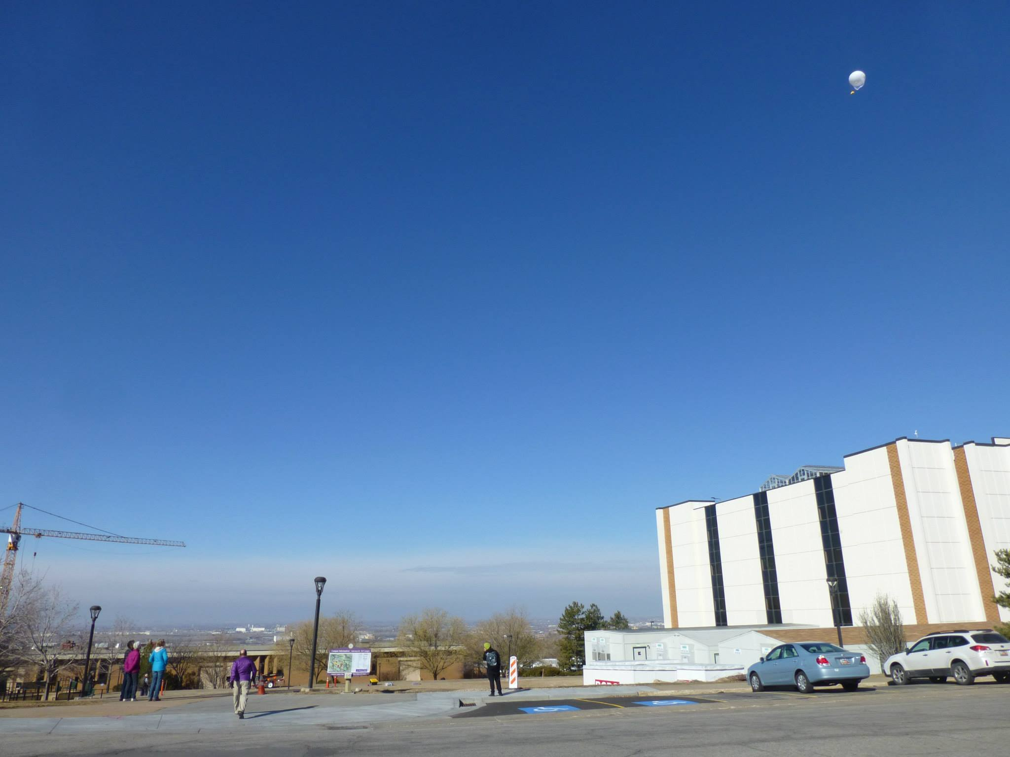

Slide 28
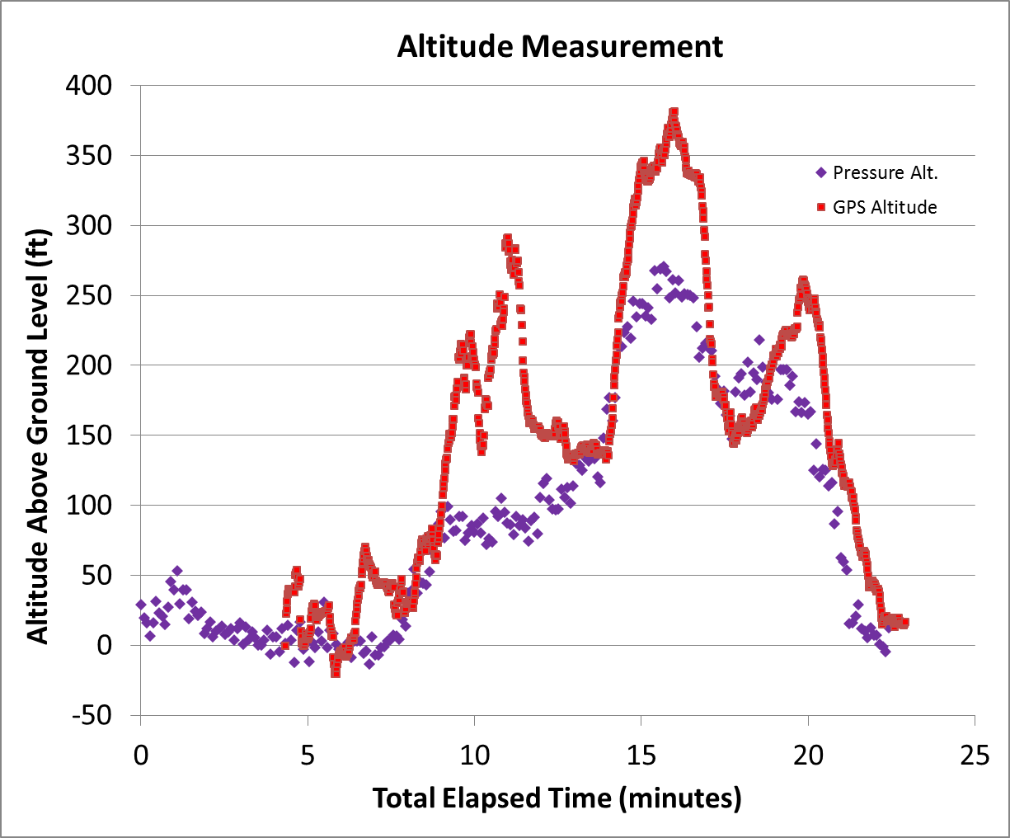

Slide 29
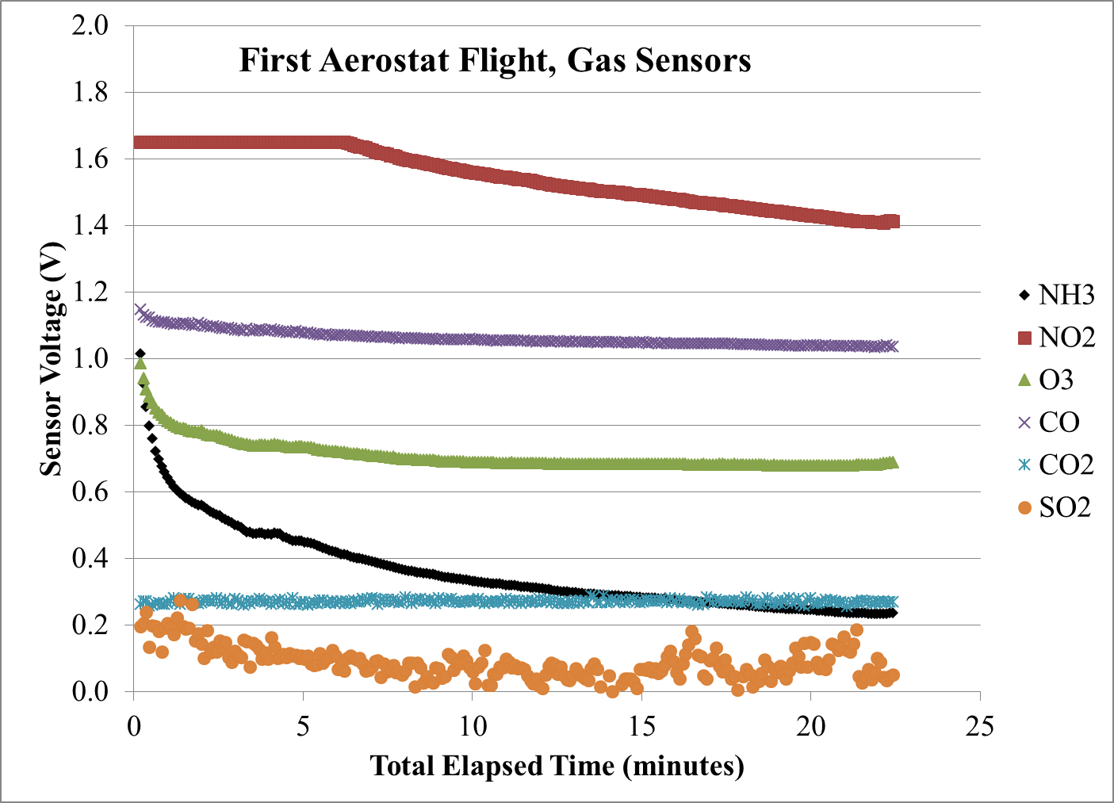

Slide 30
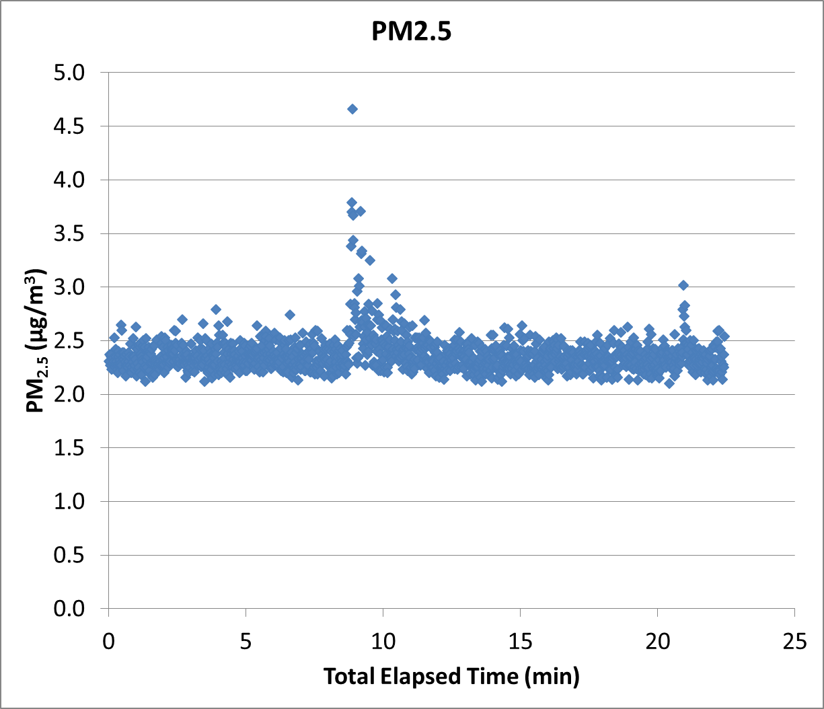

Slide 31
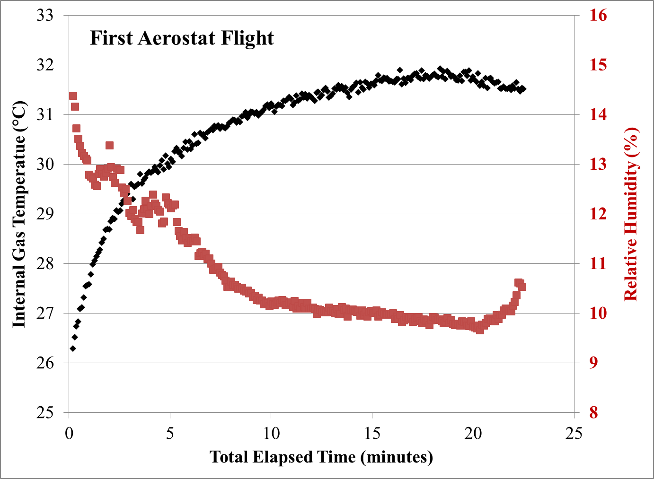

Slide 33
Launch Locations
WSU
Ogden (Grant and 32nd Street)
Harrisville (425 West 2550 North)

Slide 35
A typical High Altitude Flight

Slide 36
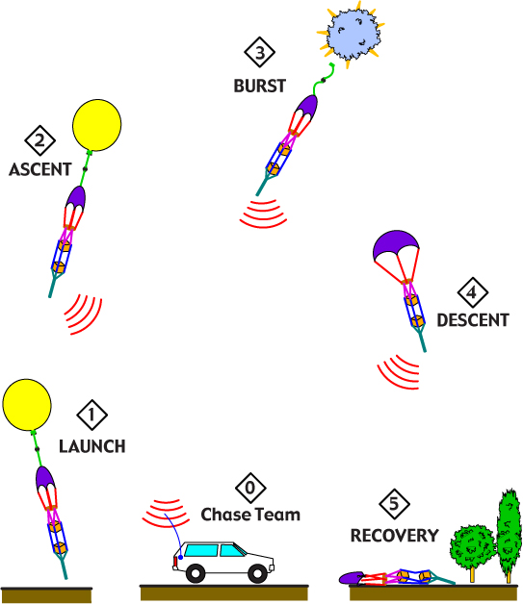
Typical Mission

Slide 37
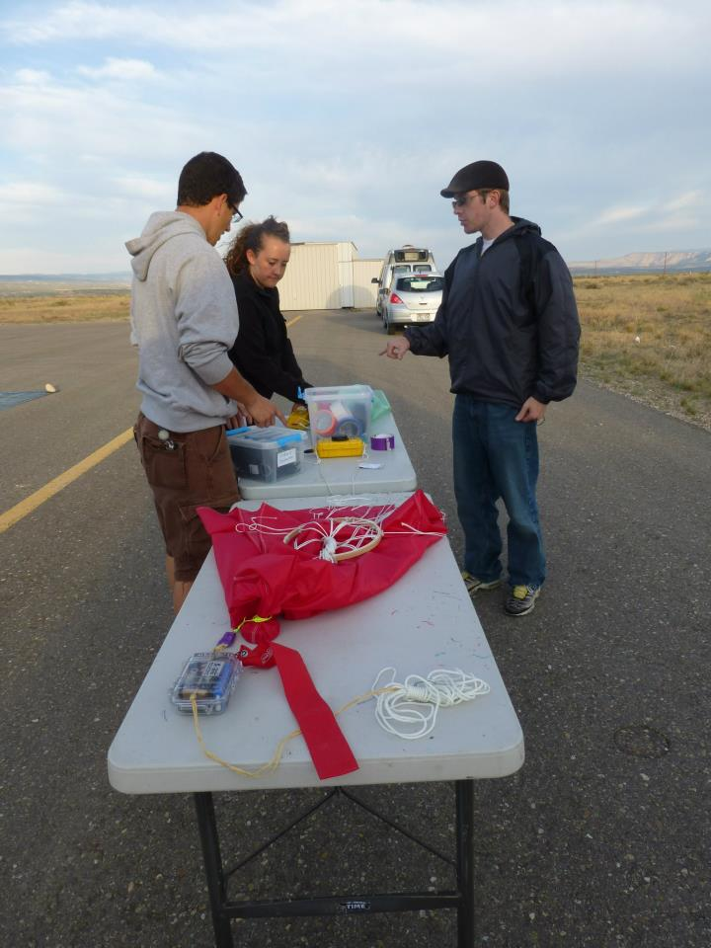

Slide 38
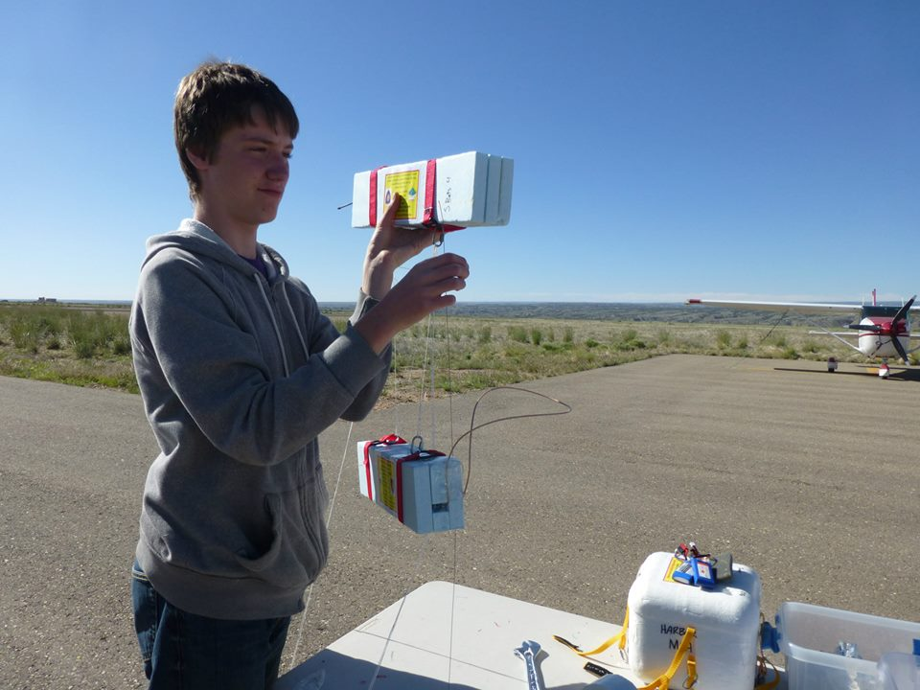
Telemetry radios are now in foam

Slide 39
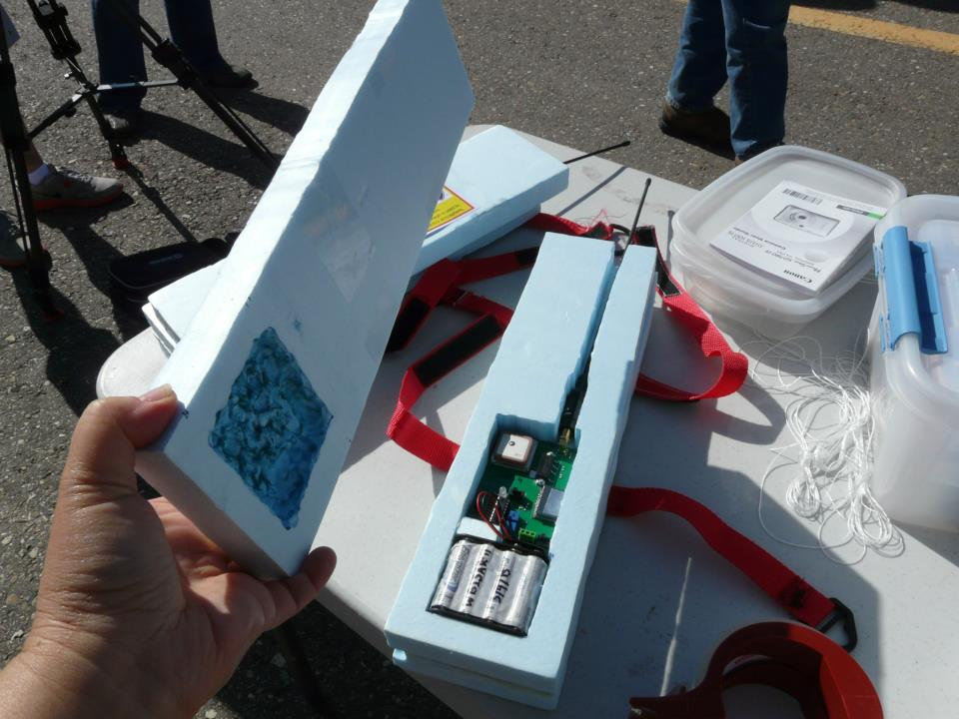
Close up

Slide 40
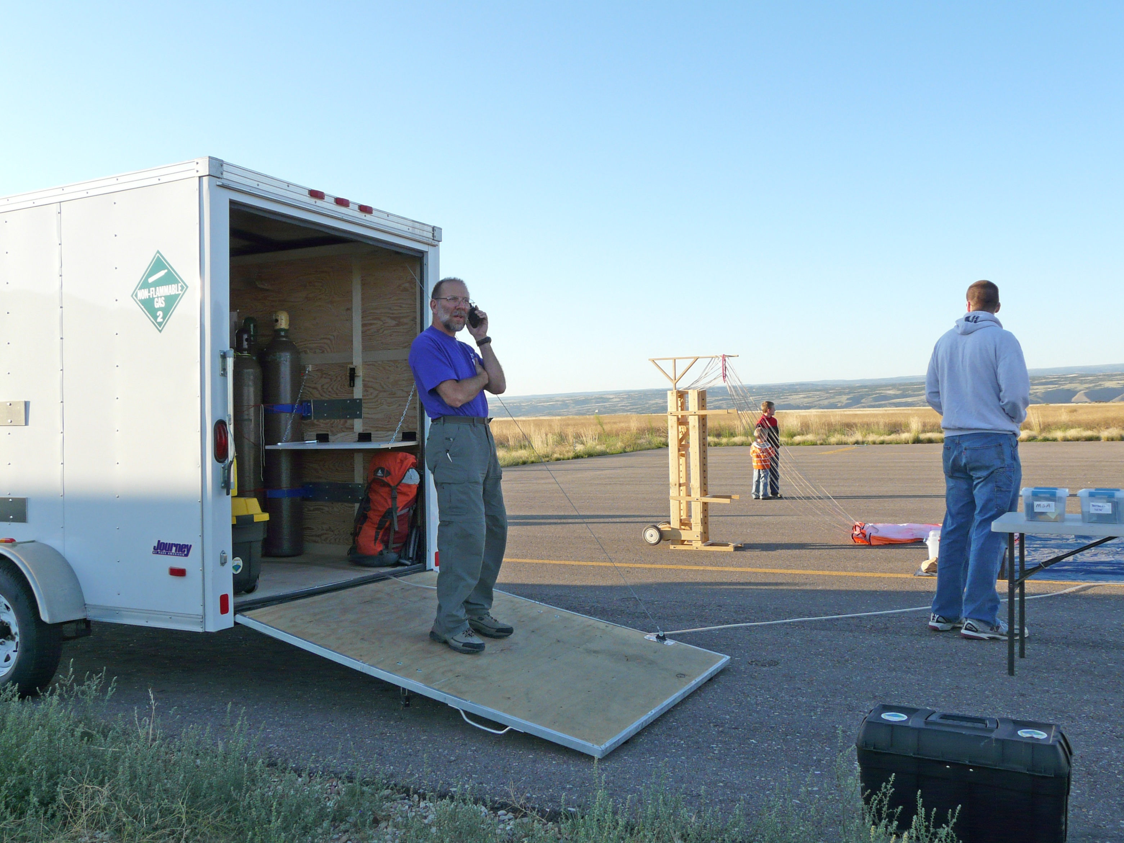
We are in nearly continual contact with the FAA
to insure aviation safety.

Slide 41
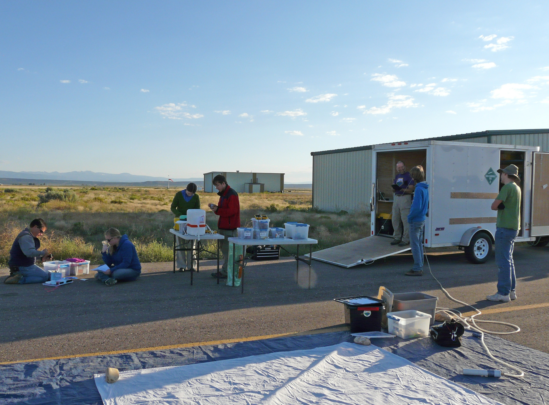

Slide 42
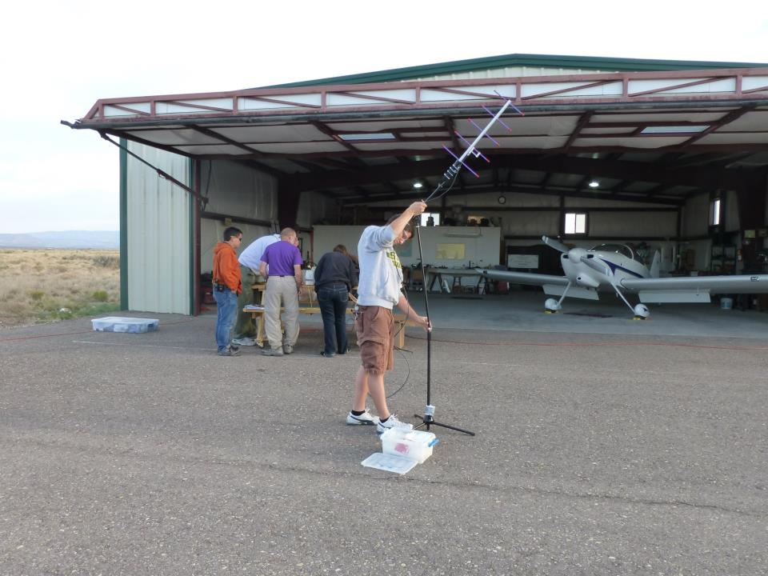
Setting up the old ozonesonde telemetry
receiving antenna.

Slide 43
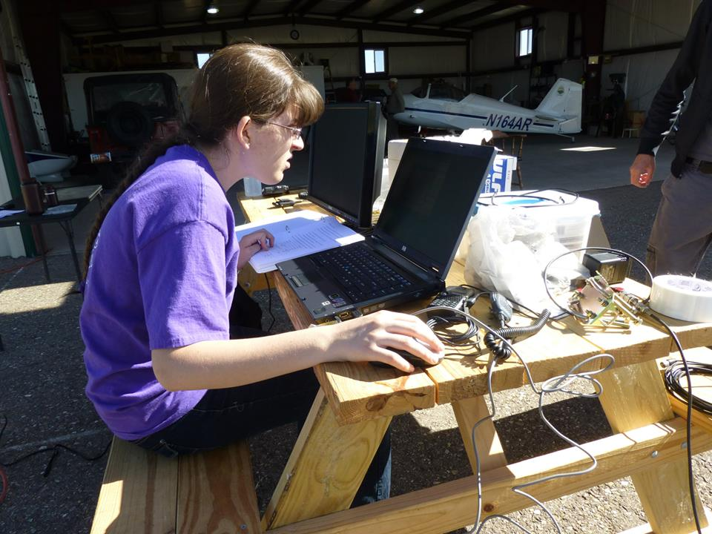
Ozonesonde signal verification.

Slide 44
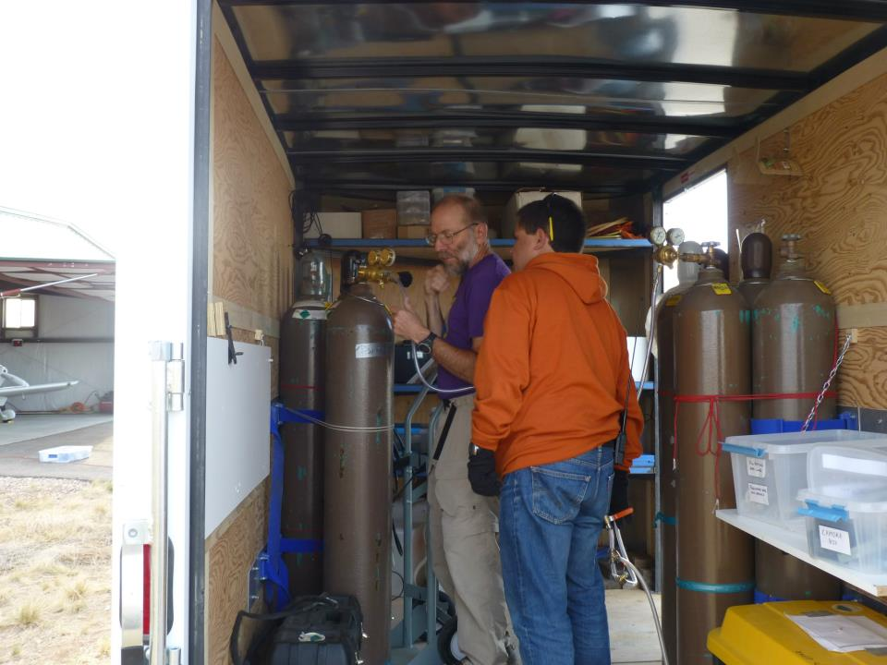
Preparing for filling the balloon.

Slide 45
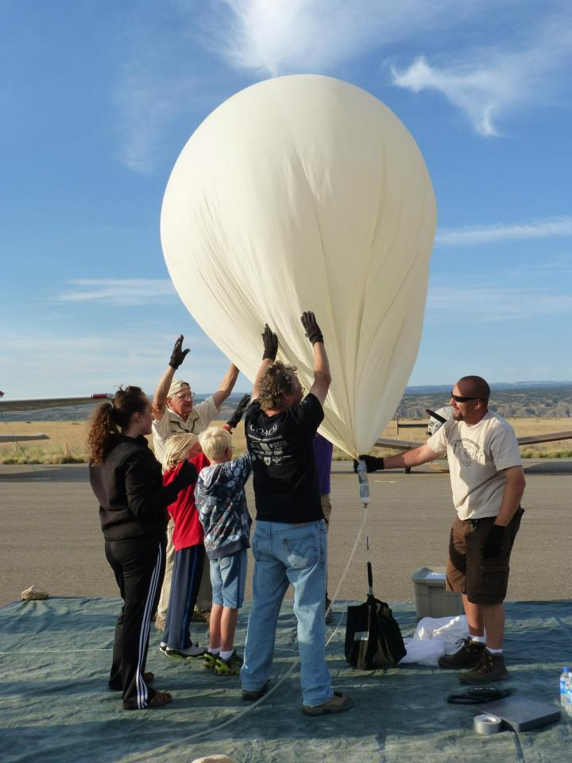

Slide 46
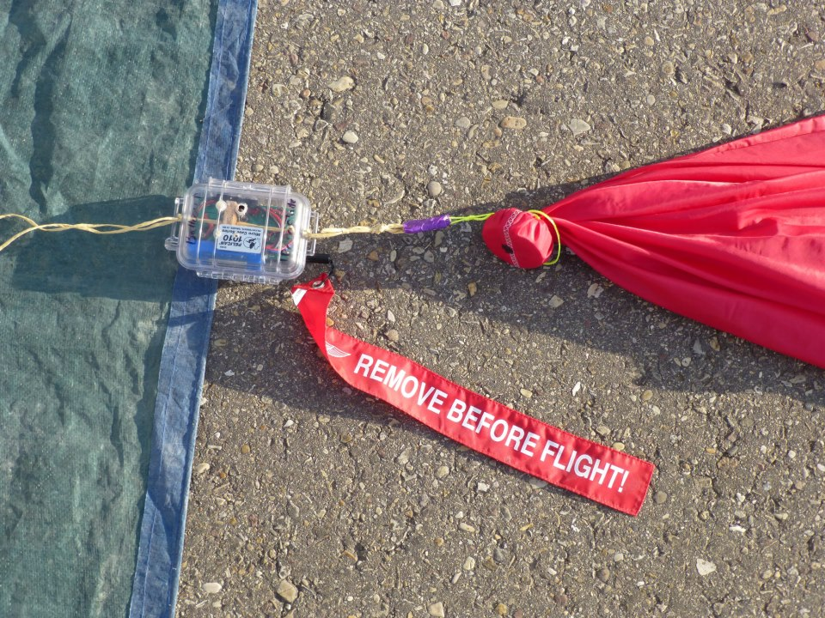
Cut-down device for emergency
cutaway from balloon.

Slide 47
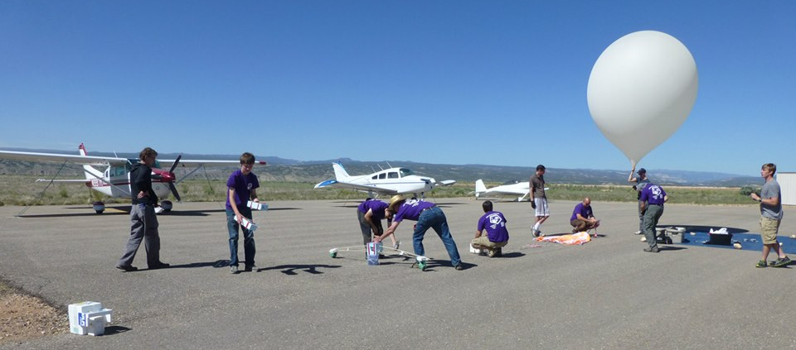
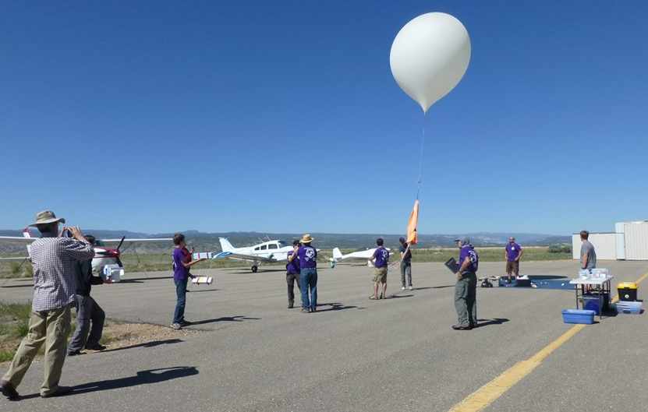

Slide 48
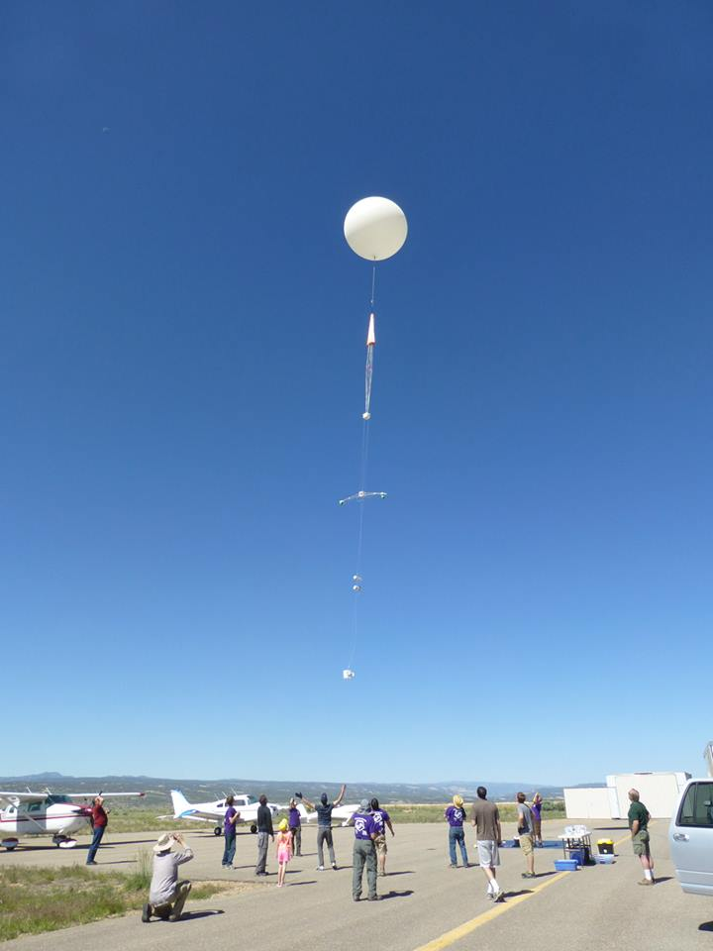
HAR130602
On the way
to Bottle
Hollow
(water landing)

Slide 49
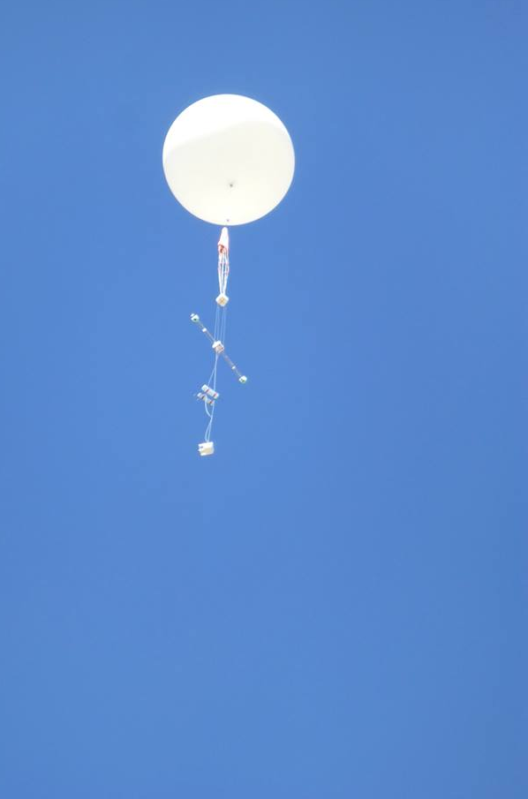
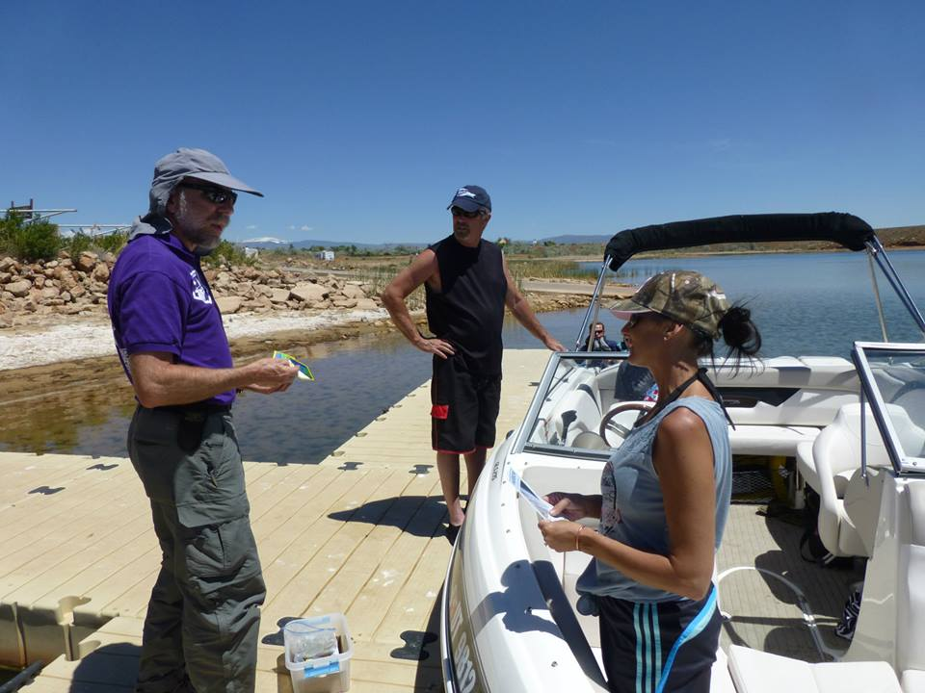
What are the odds?

Slide 50
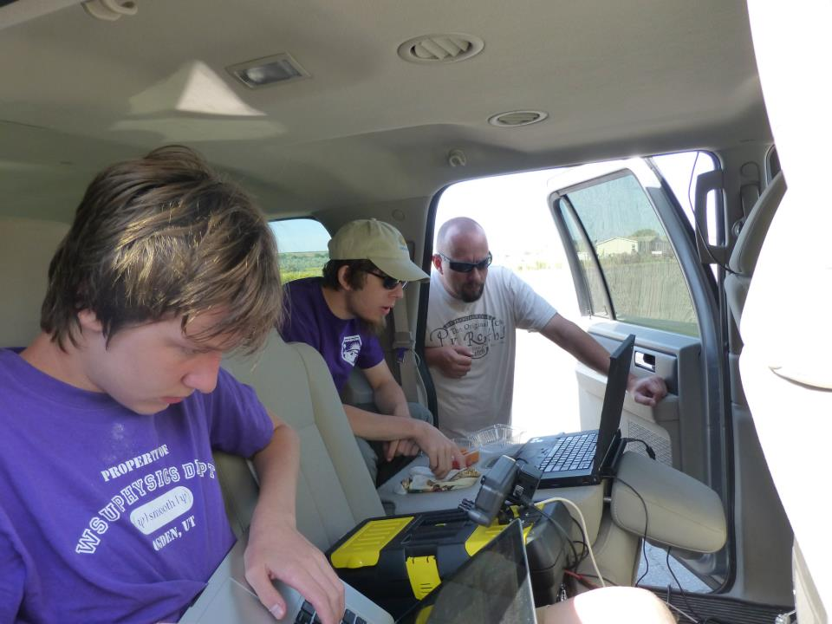
Computers inside chase
vehicle for flight tracking.

Slide 51
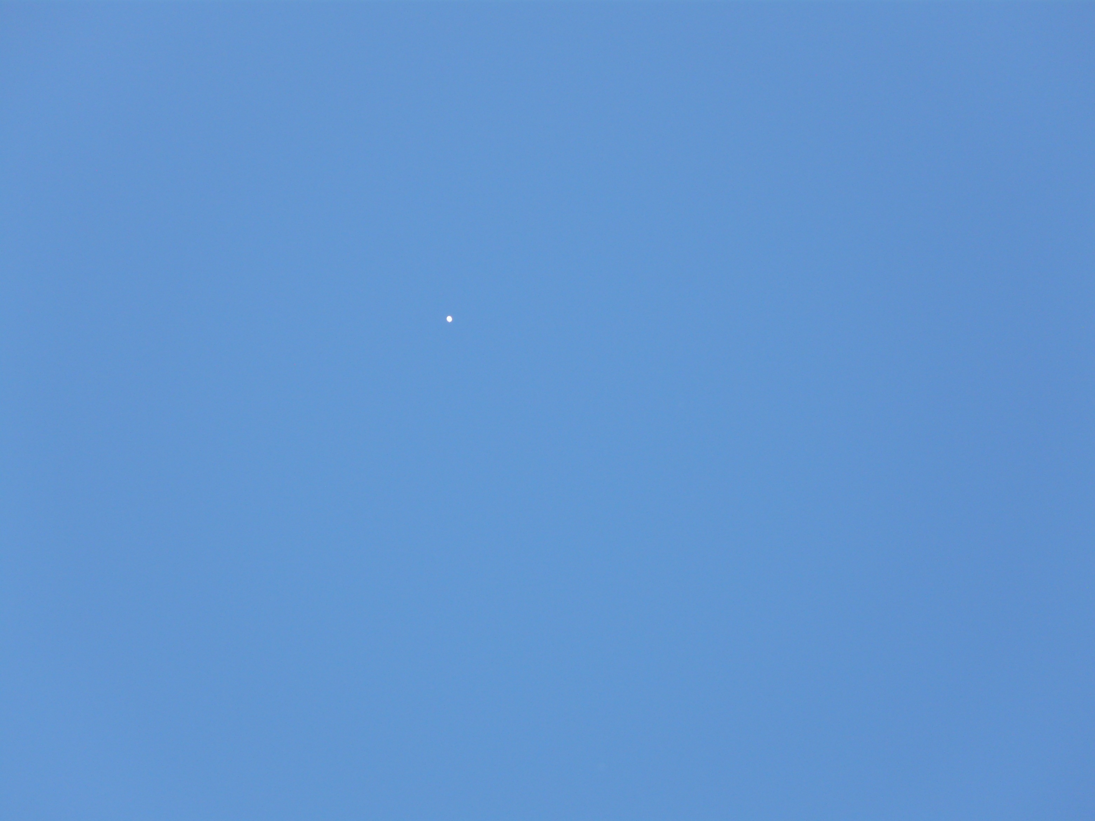
The balloon is much bigger now.
It is about 18 miles away, almost straight up.
(This photo was taken with a hand-held camera.)

Slide 52
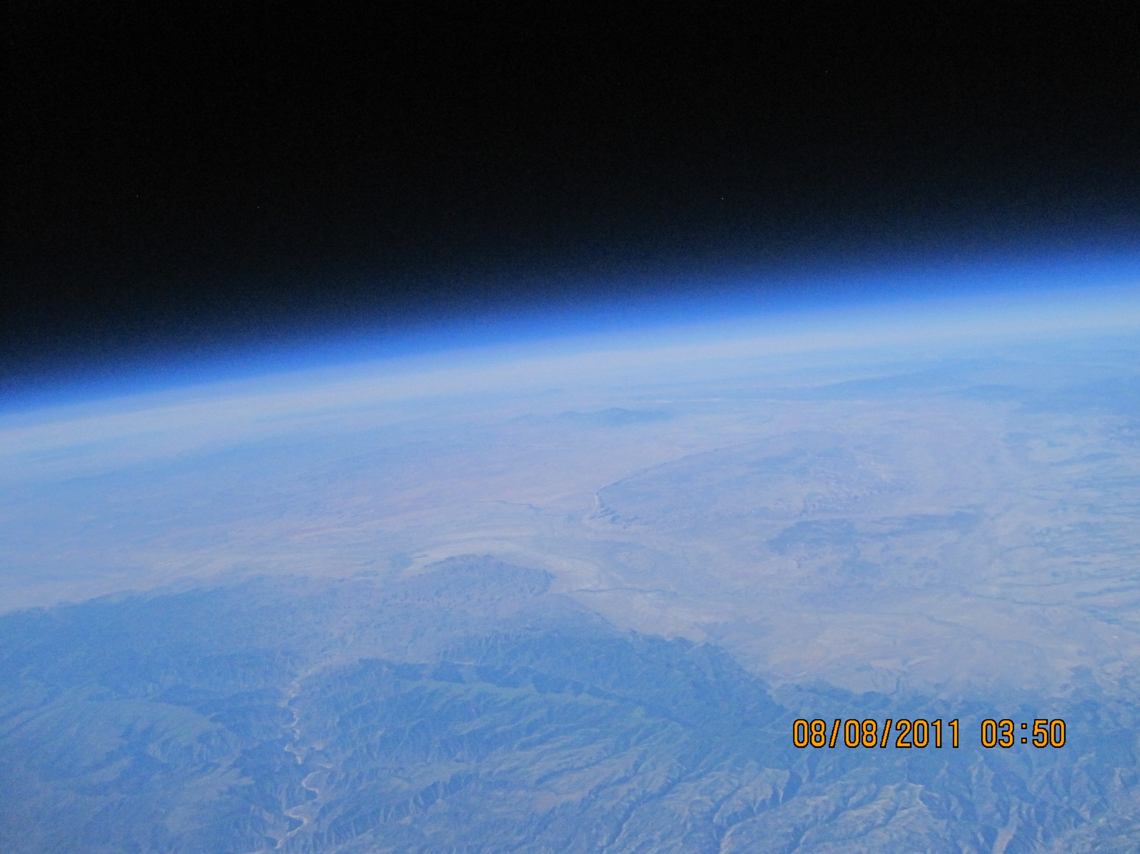
30km ASL

Slide 53
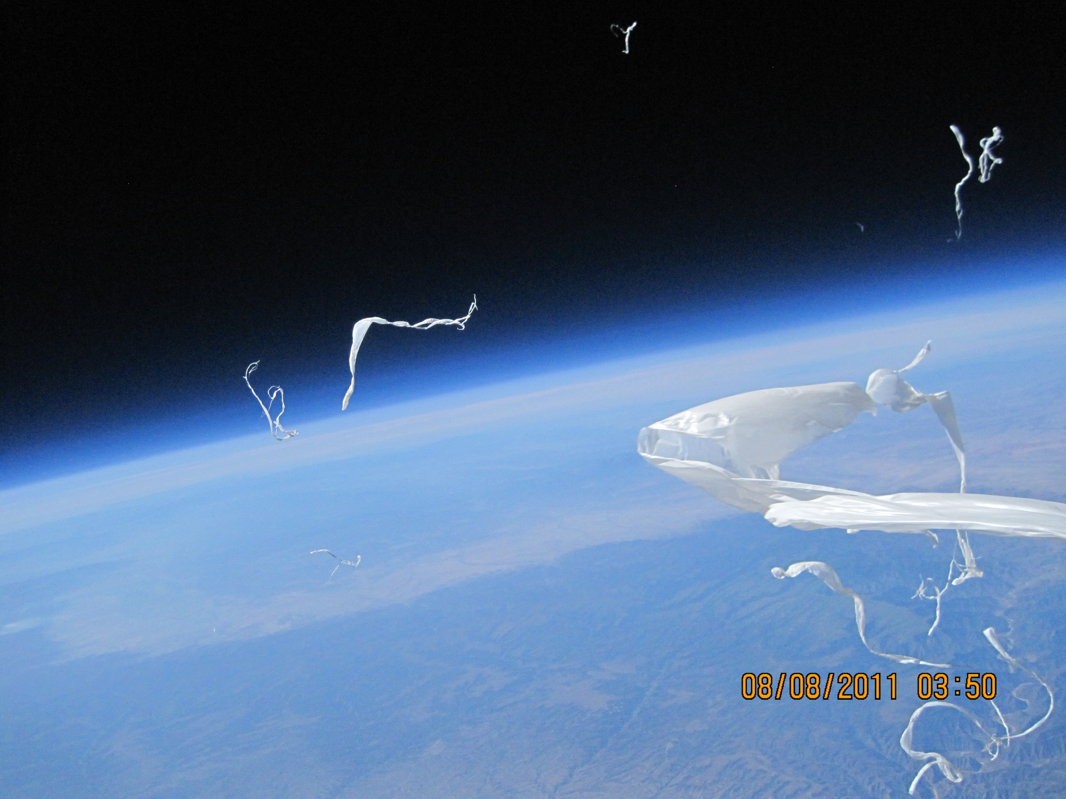
Burst.

Slide 54
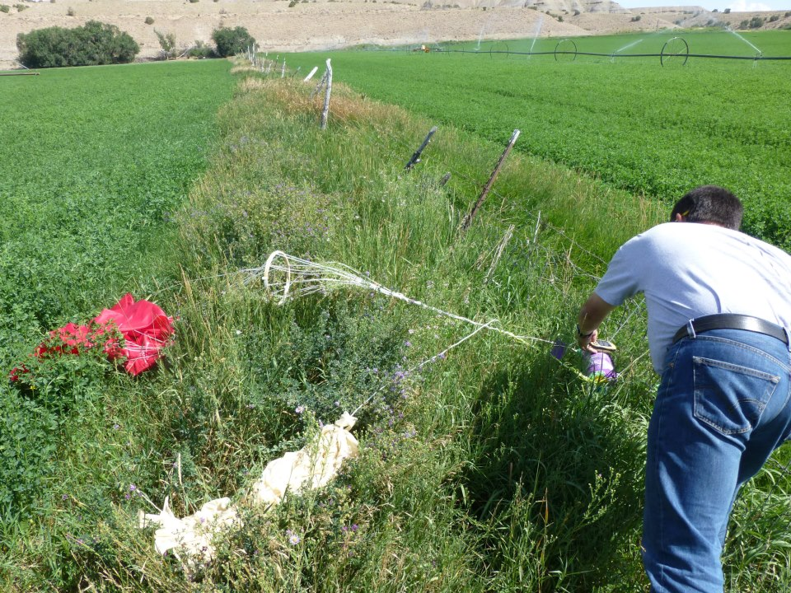
Recovery in an alfalfa field.

Slide 55
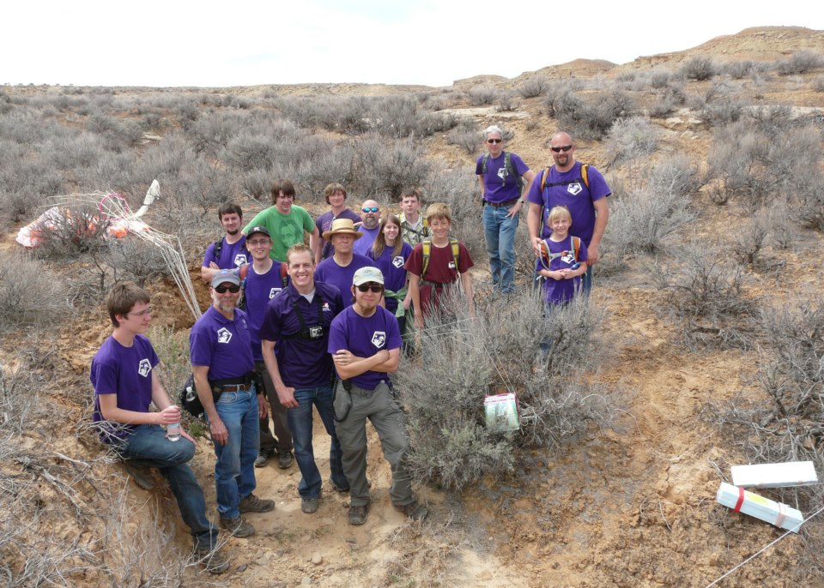
A more “typical” recovery.

Slide 56
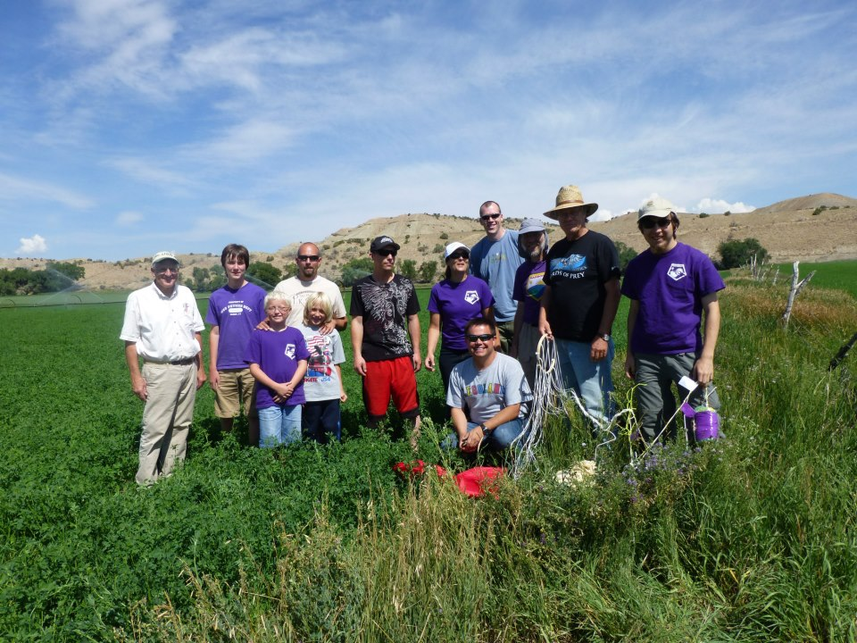
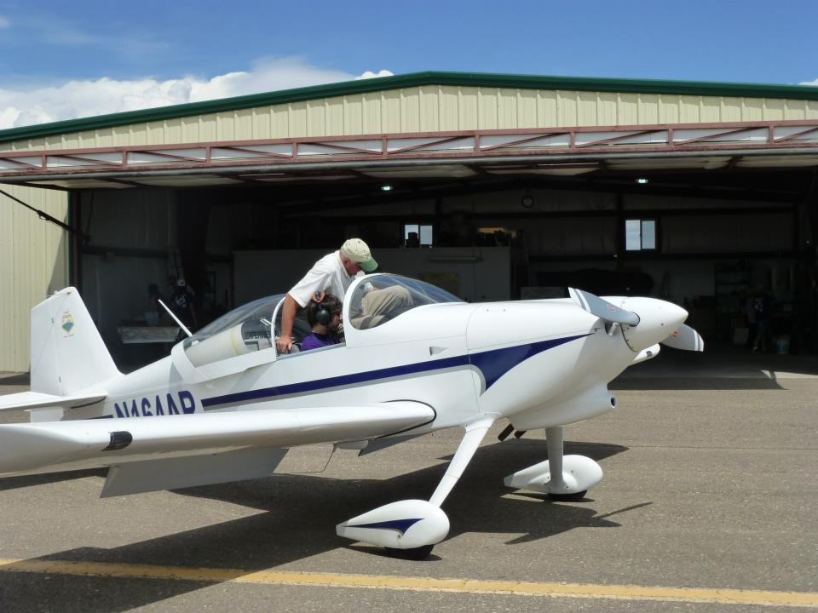
HAR120810

Slide 57
GammaScout

Slide 58
MSA Data

Slide 59
MSA Acceleration Data

Slide 60
Test Chamber

Slide 61
Test Chamber

Slide 62
Ozonesonde
Funded by: NASA Utah Space Grant
Ground-based Automatic Tracking Antenna system completed Dec. 2013.
Notes:
Dobson units explanation (very good): http://earth.rice.edu/mtpe/atmo/atmosphere/topics/ozone/o3_dobson.html

Slide 63
Raw Data
Processed

Slide 64
Ozonesonde Telemetry Live Screen Shot

Slide 65
Live Tracking

Slide 66
HiSAM
$1,500

Slide 68
Fun on the Salt Flats

Slide 70
A bigger camera platform

Slide 72
Questions?

